Slide 1

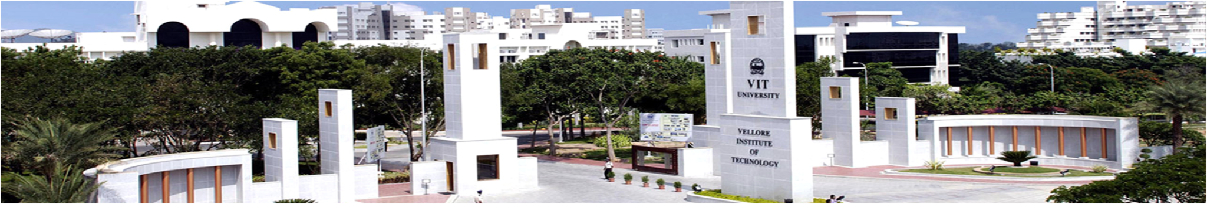
REVIEW - 2
Ranganathan S V - 18BME0374
Sridharan A P - 18BME0510
Winter 2021 - 2022: Capstone Project Presentation
Reviewer 1 : Prof. Suraj Kushe Shekhar
Reviewer 2 : Prof. Vincent Herald Wilson
Prof. Ponnambalam S G
Project Guide
PROJECT ID : 21BTECH10158
School of Mechanical Engineering
28-03-2022

Slide 2

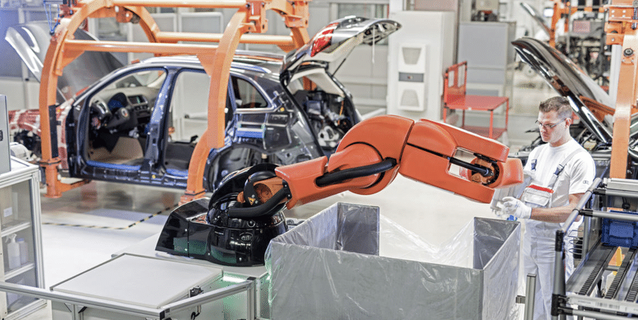
Efficient Application of Metaheuristic Algorithms for Balancing Human Robot Collaborative Assembly Lines

Slide 3

INTRODUCTION
PROBLEM DEFINITION
LITERATURE REVIEW
LITERATURE GAP
WORK CARRIED OUT SO FAR
METHODOLOGY
RESULTS
GOALS FOR NEXT REVIEW
MILESTONES
REFERENCES

Slide 4

1.INTRODUCTION
1.1. GLIMPSE OF REVIEW 1
1.2. MULTI OBJECTIVE OPTIMISATION USING PARETO APPROACH & NON DOMINATED SORTING
1.3. THE REASON FOR CHOOSING NON DOMINATED SORTING TECHNIQUE TO HANDLE MOO

Slide 5
GLIMPSE OF REVIEW 1
For the purpose of interlinking the work carried out earlier with that of what is to be presented for this review, it is worthwhile to point out that the development of different algorithms and their various parameter fine tuning was based on the following foundational tasks:
SEQUENCE GENERATION: For generating sequence, a precedence matrix is followed. Adjacency list is used to store the precedence relation efficiently and helps in generation of sequence that satisfies the precedence relations. Also, sequence dependent setup times were accounted for, which proves realistic.
SINGLE OBJECTIVE IMPLEMENTATION: Using the same novel consecutive method, task allocation was carried out for robots in an assembly line. The single objective in review-1 was focused on cycle time minimisation. The addition of sequence dependent times and setup times were included in determining optimum cycle time to make the solution obtained more feasible and realistic for industrial usage purpose.
DPSO AND HYBRID TLBO ALGORITHM: Since the HR ALB problem involves discrete population members, the traditional approaches of both PSO and TLBO were modified using special discrete operations that were defined for each operator. Parallely, hybridisation using the addition of “scoutt phase” in TLBO was developed and proved efficient functioning in terms of local minima avoidance as well as better exploration.

Slide 6
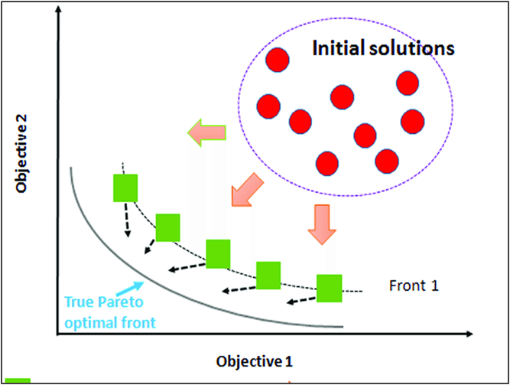
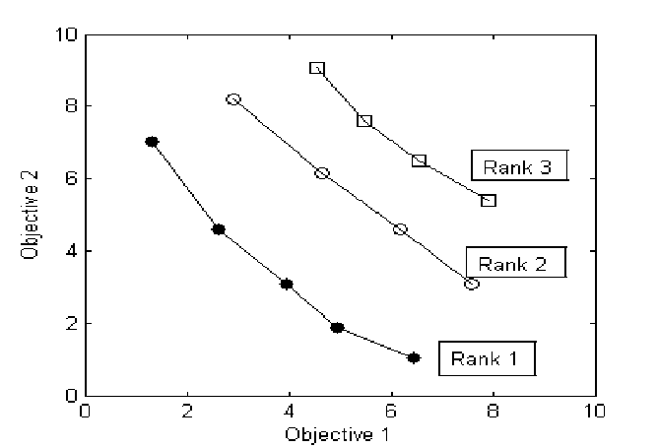
MULTI OBJECTIVE OPTIMISATION
Multi objective optimisation refers to solving multiple objectives that are conflicting in nature. As the objectives are conflicting, rather than a single optimal solution, a set of optimal solution is presented known as the pareto optimal set.
In non-dominated sorting, an individual A is said to dominate another individual B, if and only if there is no objective of A worse than objective of B.
In simple words, let us say there are two objectives f1 & f2 that is to be minimised, and two points A and B,
A dominates B if, f1(A) < f1(B) and f2(A) < f2(B)
Both lie in same front if, ( f1(A) < f1(B) and f2(A) > f2(B) ) or ( f1(A) > f1(B) and f2(A) < f2(B) )
B dominates A if, f1(A) > f1(B) and f2(A) > f2(B)
Some of the objectives in assembly line balancing problems are, To minimize the number of workstations, To minimize the cycle time, To minimize the energy consumption, To maximize the workload smoothness, etc..,

Slide 7
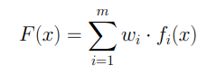
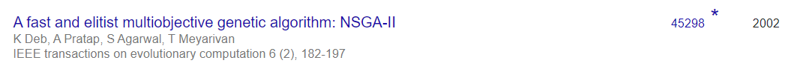
WHY NON-DOMINATED SORTING FOR MO HANDLING?
MOST COMMONLY USED METHODS TO HANDLE MULTI OBJECTIVE OPTIMISATION :-
WEIGHTED SUM METHOD - Construct a weighted sum of objectives and optimize. The difficulty with this method is that, the user must be well knowledged with the weights for each objectives as it influences the solution obtained.
CONSTRAINT METHOD - Minimize a primary objective while expressing all the other objectives in the form of inequality constraints. The difficulty with this method is that if the objectives are complex, expressing them into constraints is not effective in generating pareto optimal solutions.
NON DOMINATED SORTING WITH EXTERNAL ARCHIVE - This method as explained in the previous slide, generates many different solutions and stores them separately in an external archive.
MOST POPULARLY USED MULTI-OBJECTIVE HANDLING METHOD FOR MOST OPTIMISATION PROBLEMS:

Slide 8
2. PROBLEM DEFINITION

Slide 9
PROBLEM DEFINITION
The project aims to balance and improve the efficiency of different assembly line tasks that involves collaborative robots working hand in hand with humans. This is to be done through development of optimization algorithms by varying current metaheuristic algorithms, with an intention of less complex data processing and increased efficiency.
PROBLEM STATEMENT:
To develop metaheuristic algorithms for balancing and scheduling of assembly line operations.
Considered assembly line structure = StAL (straight line assembly line).
Only one product is assembled in the assembly line with known number of workstations.
Considering setup times and sequence dependent time.
Collectively considering constraints of ergonomics, safety, economic viability of assembly line resources.
This problem type is classified as multi objective RAL BP TYPE - II that focuses on minimising cycle time and energy consumption with given number of workstations.

Slide 10
3.LITERATURE REVIEW
3.1. RALB WITH HUMAN COLLABORATION
3.2. EFFICIENT MULTI-OBJECTIVE IMPLEMENTATION MODELS
3.3. SOME POPULAR META HEURISTIC ALGORITHMS LIKE MBO & AOA WITH HYBRID VARIANTS

Slide 11
Title of the paper | Journal & Year | Authors | Description/ Remarks
An analysis of task assignment and cycle times when robots are added to human-operated assembly lines, using mathematical programming models. | International journal of production economics, 2021 | Tamas ´ Koltai, Imre Dim´eny, Viola Gallina, Alexander Gaal, Chiara Sepe. | Puts forth three different layouts for human-robot assembly line (only human/both in a workstation/both in different workstations). An MILP approach to solve every scenario was formulated, which was referred for our problem synthesis.
Identification and classification of risk factors for human-robot collaboration from a system-wide perspective. | Computers and industrial engineering, 2022. | Nicole Berx, Wilm Decre, Ido Morag, Peter Chemweno, Liliane Pintelon. | Tabulates all possible risks in a human-robot collaborative assembly line environment, along with precedence insights of every risk. Risks are referred to effectively formulate our problem in objective of increasing ergonomics.
Balancing of assembly lines with collaborative robots. | Business Research, 2019 | Christian Weckenborg, Karsten Kieckhafer, Christoph Muller, Martin Grunewald, Thomas S. Spengler | RALB problem solution approaches and considerations that weren’t accounted for previously.

Slide 12
Title of the paper | Journal & Year | Authors | Description/ Remarks
A survey on new generation metaheuristic algorithms | Computers and Industrial Engineering 137 (2019) | Tansel Dokeroglu, Ender Sevinc, Tayfun Kucukyilmaz, Ahmet Cosar. | Insights of best performing algorithms are compared in their efficient performance, high number of citations, specific evolutionary operators, interesting interaction mechanisms between individuals, parameter tuning/handling concepts, and stagnation prevention methods.
Balancing and scheduling assembly lines with human-robot collaboration tasks | Computers and operations research 140 (2022) | Amir Nourmohammadi, Masood Fathi, Amos H.C. Ng | In addition to the traditional ALBP constraints, this paper is referred for human and robot characteristics in terms of task times, allowing multiple humans and robots at stations, and their joint/collaborative task formulations. Also, how real time industrial case study is carried out.
Designing human-robot collaboration (HRC) workspaces in industrial settings: A systematic literature review | Journal of Manufacturing Systems 62, 2022 | Ana Correia Simoes, Ana Pinto, Joana Santos, Sofia Pinheiro, David Romero | A framework that represents the complexity levels of the influencing factors in H-R workplace. The guidelines and recommendations from literature are categorised into 3 groups of H-R design layout and considerations, with increasing order of complexity.

Slide 13
Title of the paper | Journal & Year | Authors | Description/ Remarks
Cost‑oriented robotic assembly line balancing problem with setup times: multi‑objective algorithms | Journal of Intelligent Manufacturing (2021) | Zixiang Li, Mukund Nilakantan Janardhanan, S. G. Ponnambalam | Presents the cost-oriented robotic assembly line balancing problem with setup times to minimize the cycle time and total purchasing cost simultaneously. The NSGA-II is developed for multi-objective implementation and improved phases in ABC algorithm are developed to achieve a set of Pareto solutions.
Flow Time in a Human-Robot collaborative Assembly Process: Performance evaluation, System properties, and a Case study* | IISE Transactions, (2021) | Ya-jun Zhang, Ningjian Huang, Rober G. Radwin, Zheng Wang & Jingshan Li | An analytical method is introduced to evaluate the flow time of an assembly process with collaborative robots. The productivity performance of such systems are measured and system properties of monotonicity, work allocation, and bottlenecks are investigated. Also, real time industrial case study is carried out.
Mathematical model and bee algorithms for mixed-model assembly line balancing problem with physical human–robot collaboration | Applied Soft Computing Journal 93 (2020) | Zeynel Abidin Çil, Zixiang Li, ,Suleyman Mete, ErenÖzceylan | This study investigates the mixed-model ALBP with the collaboration between human workers and robots. Bee and ABC algorithms are formulated with new phases each to increase exploration and exploitation. ABC proposes a new onlooker phase to accelerate the evolution of swarm, new scout phase to achieve high-quality solutions and preserve diversity of swarm, and local search to enhance exploitation.

Slide 14
Title of the paper | Journal & Year | Authors | Description/ Remarks
Multi-objective migrating bird optimization algorithm for costoriented assembly line balancing problem with collaborative robots. | Neural Computing and Applications (2021) | Zixiang Li, Mukund Nilakantan Janardhanan, Qiuhua Tang. | The complete methodology of MBO algorithm applied for assembly line balancing with collaborative robots. Provides insights on hybridisation of MBO and use of NSGA-II for solving multi-objective problems.
Archimedes optimization algorithm: a new metaheuristic algorithm for solving optimization problems | Applied Intelligence, 2020 | Fatma A. Hashim, Kashif Hussain, Essam H. Houssein, Mai S. Mabrouk, Walid Al-Atabany. | Shows the implementation methodology of AOA algorithm, its meaning and significance for solving optimization problems.

Slide 15
4. LITERATURE GAP

Slide 16
LITERATURE GAP
Since the study started on RAL BP, only 33 articles were published till date since 1991(over 30 years). The research on this field was less and skyrocketed recently (2015-2019).
Since 1997, most of the researchers started using deterministic variable task times that were determined on the types of robots. This was due to the development in technology that resulted in invention of many different robots that can perform all the tasks.
Mathematical models were used to describe the relations between the different objectives and to handle the constraints effectively. As the size of the problem increased, meta-heuristics started dominating the other methods. Many meta-heuristics were developed to tackle this NP-hardness of the RALBP.
Introduction of Cobots(collaborative robots) to the assembly line, created a new trend in the research area of RALBP. This use of cobots in the assembly line showed better results and gained interest by many industries. As this area of research is quite new, only few papers were published since 2019.
Many real life constraints such as tools assignment, tool space optimization, etc.., were not addressed in most of the papers and this could be the future in the study of RAL BP.

Slide 17
LITERATURE GAP
Almost all the research on RALBP assume fully automated assembly line which requires huge investments. Not all the industries are capable to do such investments and still many of the industries slowly started to introduce robots in their assembly lines. So the study on human robot collaboration assembly line could be a great research area as many industries opt them as they are easy and require less investment.
The studies that included cobots in the assembly line mostly preferred only one robot in a workstation. Research study on multiple robots and humans working in parallel could be a great area of research. As humans started working alongside robots, study of ergonomics and real life constraints such as human fatigue, sequence dependent setup times, tool and accessory changing, part transportation between stations, etc.., can be included in RABLP as no one has ever did that previously due to its high complexity.
Most industries focus on only one objectives while designing assembly lines rather than many. Research on Multi objective optimizations could be more relevant to real life problems. As introduction of multi objectives create more complexity, many meta-heuristics were developed. From the recent studies, hybrid metaheuristics showed better results than meta heuristics. So study on hybrid metaheuristics on solving multiple objectives could create a way for finding better pareto optimal solution sets.

Slide 18
LITERATURE GAP (POST REVIEW 1)
In-line with the growing interests and developments in human-robot collaborative assembly line balancing problems using metaheuristics, “standard testing datasets” of different task sizes for H-R ALBP aren’t available for researchers who may use such reliable and readymade datasets to test different algorithms.
Due to several intricate considerations in designing a H-R collaborative assembly line, a broad range of publications in this little researched domain haven’t “collectively” emphasised flexible and realistic constraints with respect to individual task abilities of humans and robots, collaborative work safety, economic production. (COLLECTIVELY DEVELOPED CONSTRAINTS FOR OUR PROBLEM SHALL BE DEMONSTRATED)
A very recent algorithm called “ARCHIMEDES OPTIMISATION ALGORITHM” or AOA is implemented to solving our H-R ALB problem. This algorithm is very recent, has less development fatigue and importantly, has never been used for solving any line balancing problems before. To make things interesting, this algorithm performs slightly better than all algorithms considered by us for our problem (SHOWN IN RESULTS SECTION)

Slide 19
5.WORK CARRIED OUT SO FAR
5.1. DATA GENERATION FOR HRC ASSEMBLY LINE
5.2. ENCODING AND DECODING
5.3. IMPLEMENTATION OF CONSTRAINTS FOR HRCAB

Slide 20

DATA GENERATION

Slide 21
DATA REQUIRED & SOME ASSUMPTIONS MADE FOR HRC
Number of tasks
Number of robots
Operation time table for all robots, cobots and the human
Setup times for robots
Sequence dependent times for robots
Precedence matrix
Energy Consumption by robots and the human
Some of the assumptions made while generating the data are,
Number of cobots = Number of robots
Cobot_i = Robot_i + Human
Only one type of worker (all workers are equally skilled)
The lower bound and upper bound of operation times are used for calculation of lower and upper bounds of other data (setup time, sequence dependent time).
Energy consumption of robots and the human is given in Wh/min. [0.10 - 0.30] Wh / min

Slide 22
TUNING PARAMETERS USED
Number of tasks
Number of robots
Lower bound(lb) and upper bound(ub) for operation time of robots table
c1, c2, c3, c4 (parameters [range from 0 to 1] that control the lower and upper bounds of setup time and sequence dependent time)
Lower bound of operation time for co bot = lb
Upper bound of operation time for co bot = ub - (c1 * (ub - lb))
Lower bound of operation time of human = lb + (c2 * (ub - lb))
Upper bound of operation time of human = ub + (c2 * (ub - lb))
Lower bound of sequence dependent time = c3 * lb
Upper bound of sequence dependent time = c4 * lb
Lower bound of setup time = c1 * lb
Upper bound of setup time = c2 * lb

Slide 23
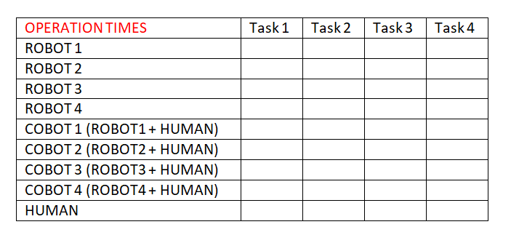
OPERATION TIME
Is assumed to be in minutes and the data type used is integer
Dimension = r X n, where
r = (number of robots * 2) + 1
n = number of tasks

Slide 24
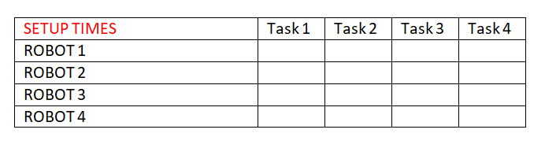
SETUP TIME
Is assumed to be in minutes and the data type used is integer
Dimension = r X n, where
r = number of robots
n = number of tasks

Slide 25
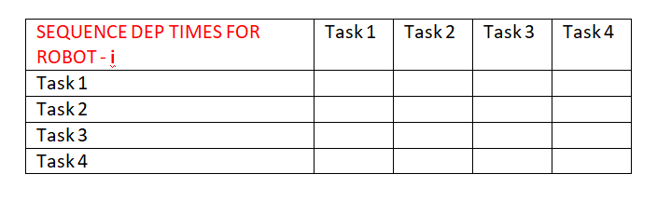
SEQUENCE DEPENDENT TIME
Is assumed to be in minutes and the data type used is integer
Dimension = r X [ n X n ], where
r = number of robots
n = number of tasks

Slide 26
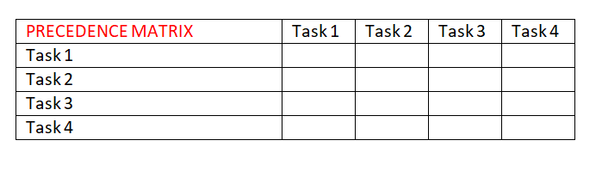
PRECEDENCE MATRIX
The data in this matrix is either 0 or 1 where 0 means no precedence relation and vice versa.
Dimension = n X n, where
n = number of tasks

Slide 27
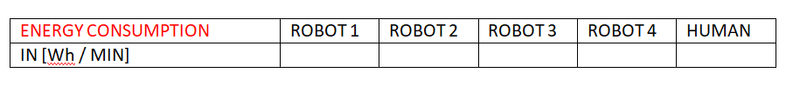
ENERGY CONSUMPTION
The data is in from or array where the energy consumption per min of robots and the human is given. Data type used is double.
Dimension = 1 X (r+1), where
r = number of robots

Slide 28
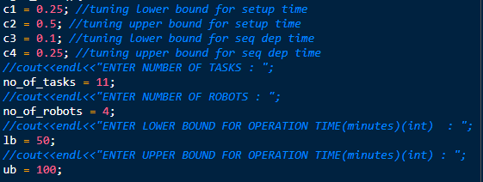
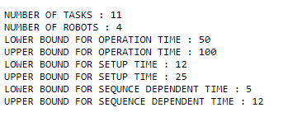
RESULTS OBTAINED FROM THE DEVELOPED CODE

Slide 29
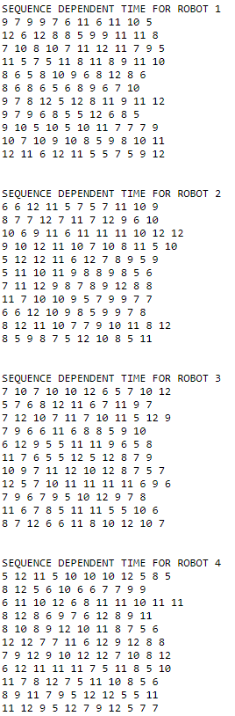
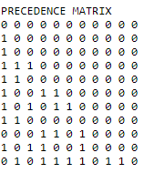
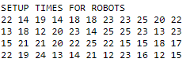
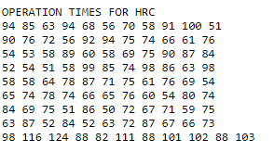
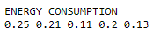

Slide 30
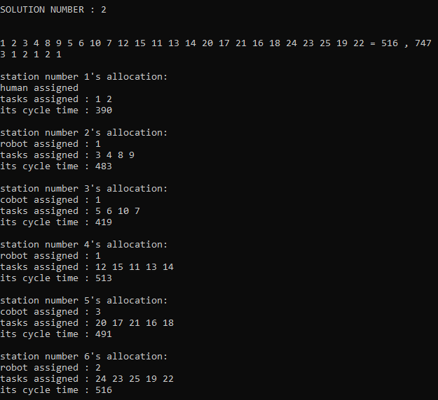
ENCODING AND DECODING TO OUR PROBLEM
ENCODING
DECODING
→ A sequence of tasks (following precedence relation) is used to represent the order of tasks to be performed. Similarly, a sequence of process alternatives representing numbers between 1-3 for each station representing,
1 - Only robot is allocated
2 - COBOT (robot + human) is allocated
3 - Only human is allocated
For example, a 25 tasks, 6 stations encoding sequences looks like,
TASK PERMUTATION - 1 2 3 4 8 9 5 6 10 7 12 15 11 13 14 20 17 21 16 18 24 23 25 19 22
PROCESS ALTERNATIVES - 3 1 2 1 2 1

Slide 31



HUMAN ROBOT COLLABORATION IN ASSEMBLY LINE BALANCING
Not all tasks can be automated due to the lack of flexibility with available robotic technologies. Humans are flexible, adaptable according to market demands, and also have decision making skills with creativity. Therefore, human robot collaboration is prevalent where the skills of human and the speed, endurance, and accuracy of robots are brought together to increase production. This introduction of human robot collaboration leaves us with three possibilities, to find the best possible assembly line task allocation combination.
Only workers are present in workstation
Only robots are present in the workstation
Both workers and robots are present in the workstation

Slide 32
HUMAN ROBOT COLLABORATION IN ASSEMBLY LINE BALANCING
TASK CONSTRAINTS with respect to the ability of each type of robot, cobot(human+worker) and human in carrying out each individual task are taken into account. Inculcation of task constraints proves flexible and realistic for any entity that needs a fix to their semi-automated assembly line. In our problem, we take this into account by defining a constraint matrix that defines the “task ability/disability” (represented by 1 & 0 respectively) of all possible combinations of the 3 aforementioned workstation configuration possibilities with each listed task.
CONSTRAINT | TASK 1 | TASK 2 | TASK 3 | TASK 4 | TASK 5
ROBOT 1 | 1 | 1 | 0 | 1 | 1
ROBOT 2 | 1 | 1 | 1 | 1 | 1
ROBOT 3 | 0 | 0 | 1 | 1 | 0
COBOT 1 (robot 1 + human) | 1 | 1 | 1 | 1 | 1
COBOT 2 (robot 1 + human) | 1 | 0 | 1 | 1 | 1
COBOT 3 (robot 1 + human) | 1 | 1 | 1 | 0 | 0
HUMAN | 0 | 1 | 0 | 1 | 0

Slide 33


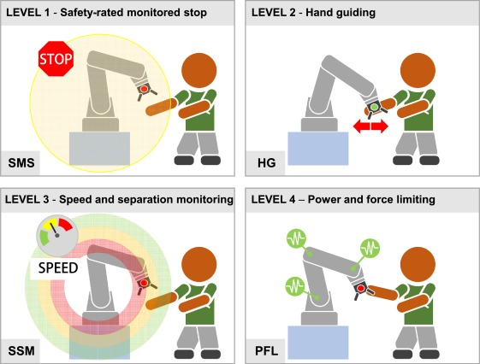
HUMAN ROBOT COLLABORATION IN ASSEMBLY LINE BALANCING
WORKSTATION CONSTRAINT is another such realistic model inculcated in line with other constraints. The constraint is such that “no two consecutive workstation shall have the same worker configuration”. This constraint adds to the practicality of limited automation investments in the line, as well as a spread in workforces, leveraging the flexibility and utter ability of humans to tackle problems at any point of the assembly line.

Slide 34
6.METHODOLOGY
6.1. MIGRATING BIRD OPTIMISATION ALGORITHM
6.2. ARCHIMEDES OPTIMISATION ALGORITHM
6.3. HYBRIDISATION FOR ALGORITHMS
6.4. USING PERFORMANCE INDICATORS FOR COMPARISON OF ALGORITHMS

Slide 35
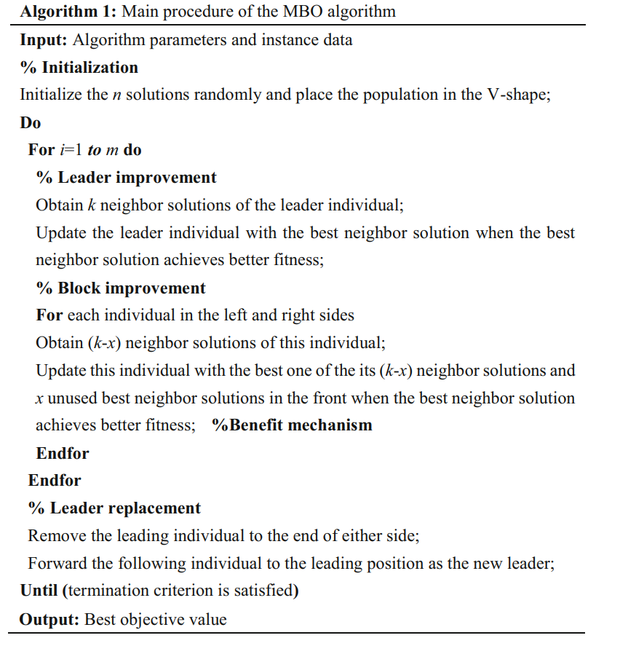

GENERAL FLOW OF MBO

Slide 36

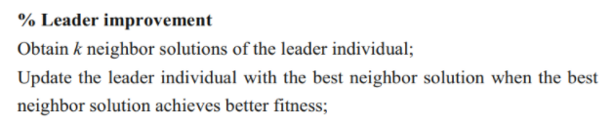
LEADER IMPROVEMENT
First the leader is found using NDS(non dominated sorting) & CD (crowding distance) - similar to PSO’S g_best.
To obtain neighbour solutions, two methods are proposed. They are,
By changing the task sequence (k/3)
By changing the process alternative sequence (k/3)
By changing both (k/3)
This k is fixed as, k = 10%-20% of the population size.

Slide 37
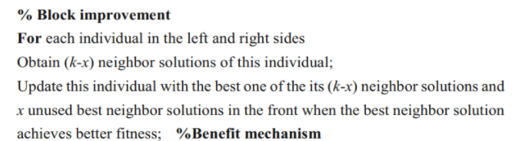
2. BLOCK IMPROVEMENT
Each individual in the left and right just means that, solutions other than g_best.
To obtain neighbour solutions, same methods as mentioned before is used. They are,
By changing the task sequence ((k-x)/3)
By changing the process alternative sequence ((k-x)/3)
By changing both ((k-x)/3)
This x here is fixed as any number less than k. Can be generated randomly or fixed.

Slide 38
CHANGING THE TASK SEQUENCE PROCESS ALTERNATIVES
To change and find neighbor solutions of a particular solution,
First a random number ‘r’ is generated between (1 - n), where n = no. of tasks
Then the tasks in position (1 - r) are kept unchanged and the tasks from position (r+1 - n) are shuffled randomly such that precedence relation is followed. For example, (taking 11 tasks)
BEFORE CHANGING - 1 3 4 7 8 2 6 9 5 11 10
RANDOM NUMBER GENERATED ( r ) - 4
AFTER CHANGING - 1 3 4 7 6 9 8 2 5 10 11
To change and find neighbor solutions of a particular solution,
SWAPPING and SINGLE POINT MUTATION (randomly picking a position and changing its value) is performed such that the constraints are satisfying. For example for a 4 station problem,
BEFORE CHANGING - 1 3 1 2
AFTER PERFORMING SWAP - 1 3 2 1 (last two positions are swapped)
AFTER SINGLE POINT MUTATIONS - 2 3 2 1 (1st position is mutated)

Slide 39
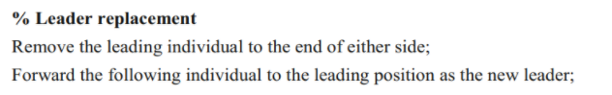
3. LEADER IMPROVEMENT
This leader replacement phase removes the leader and replaces it with better candidate from either side.
This helps the flock of birds to head to better direction/solution space and arrive at better pareto front.

Slide 40
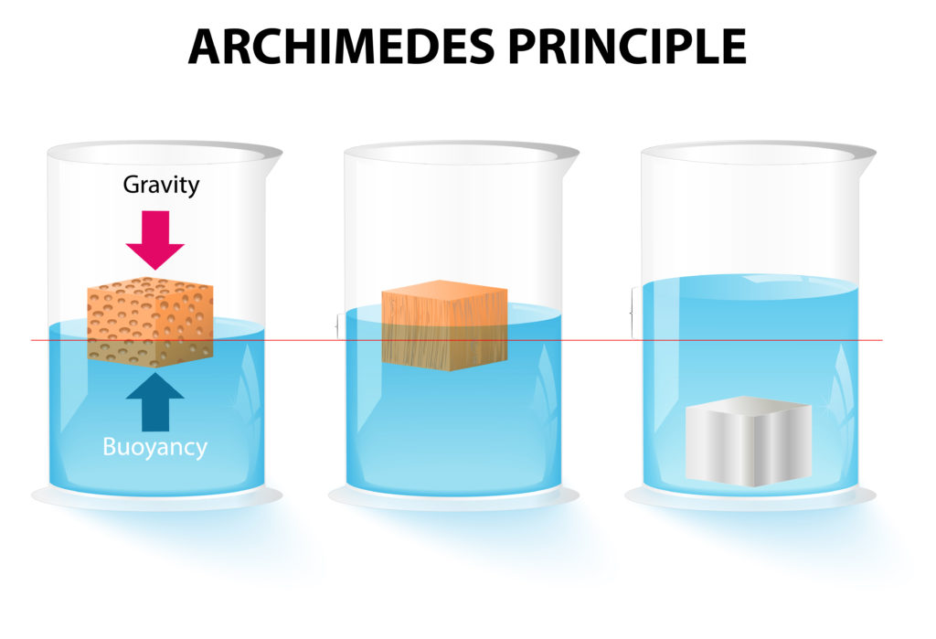
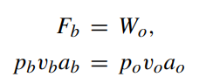
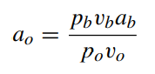
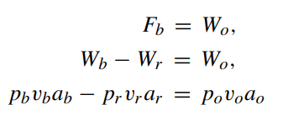
GENERAL WORKING AND FLOW OF AOA
The AOA or Archimedes optimisation algorithm works on the basis of Archimedes principle, where buoyant force is exerted on objects partially immersed in water, to maintain their equilibrium.
Assuming multiple objects immersed in the same fluid, where the objects are analogous to each population member and the fluid media is the search space, each object(member) tries to reach equilibrium (optimised state), which is if the respective buoyant force Fb is equal to the their individual weights Wr.
MATHEMATICAL FORMULAE USED:
p → Density;
v → Volume;
a → acceleration due to gravity;
Subscripts: b for fluid and o for each immersed object.
}
The equilibrium state equation used when there is another force influenced on the object like collision with another neighbouring
object (r)

Slide 41
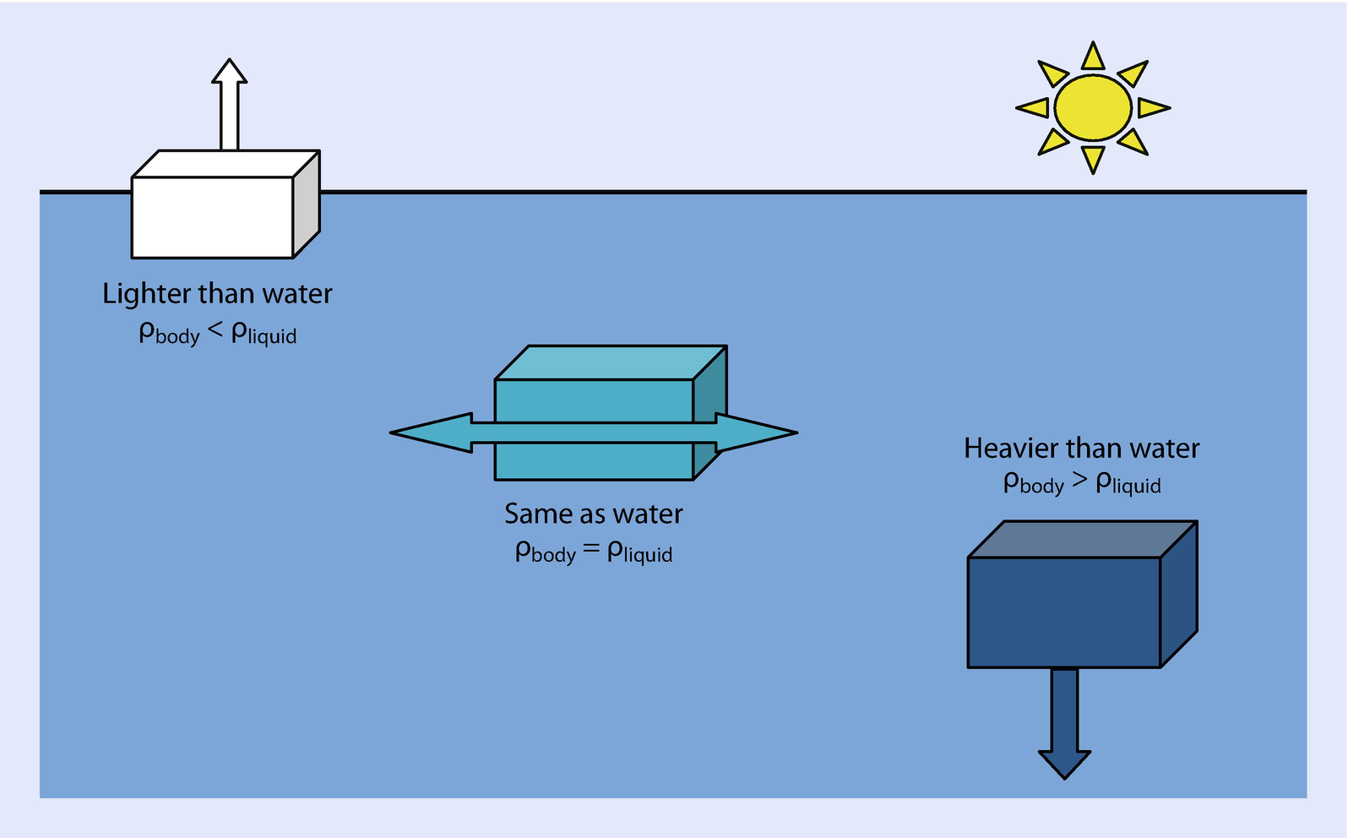

GENERAL FLOW OF AOA
Initialize a random population, velocity, density, volume, acceleration
For t=1 to T (termination criteria)
For i=1 to P (population size)
1. UPDATE density ([1 x P] array) and volume ([1 x P] array)
2. UPDATE TF (transfer operator) & d (density decreasing factor)
3. UPDATE acceleration ([1 x P] array)
4. NORMALISE acceleration
5. UPDATE POPULATION using the updated parameters
END
END

Slide 42
WORKING OF MODIFIED AOA
UPDATION OF DENSITY & VOLUME
2. UPDATION OF TF & d
→ Initial density and volume for each object of the population is generated randomly as a variable between [0-1]. Then for next iterations, the equations:
den(i)_t+1 = den(i)_t + r * (den_best - den(i)_t)
vol(i)_t+1 = vol(i)_t + r * (vol_best - vol(i)_t)
where,
den(i)_t → density of i’th object in t’th iteration
den_best → density of best object in that population
vol(i)_t → density of i’th object in t’th iteration
Vol_best → density of best object in that population
r → random number between (0-1)
→ The TF and d are the fine tuning parameters, which are calculated as the iteration progresses, rather than tuned by user.
This makes this algorithm to be more randomized and exploit the search space, without having any user-defined bias.
TF_t = exp ( ( t - t_max ) / t_max )
d_t = exp ( ( t_max - t ) / t_max ) ) - ( t / t_max)
where,
TF_t → transfer operator for t’th iteration
t_max → maximum number of iterations
d_t → density decreasing factor for t’th iteration

Slide 43
WORKING OF MODIFIED AOA
3. UPDATION OF ACCELERATION
4. NORMALISATION OF ACCELERATION
→ Initial acceleration for each object of the population is generated randomly as a variable between [0-1]. Then for next iterations, the equation:
acc_i = ( (den_r + vol_r * acc_r) / (den_i * vol_i ) IF TF <= 0.5
(exploration phase - when collision between object occurs)
acc_i = ( (den_best + vol_best * acc_best) / (den_i * vol_i ) TF > 0.5
(exploitation phase - when there is no collision between objects)
where,
acc_i → acceleration of i’th object
den_best → density of best object in that population
den_r → density of r’th object (‘r’ is generated randomly)
vol_best → volume of best object in that population
vol_r → volume of r’th object (‘r’ is generated randomly)
acc_best → acceleration of best object in that population
acc_r → acceleration of r’th object (‘r’ is generated randomly)
→ The updated acceleration of each object is then normalised as:
acc_i(norm) = (u * (acc_i - acc_min) / (acc_max - acc_min) ) ) + l
Where,
acc_i(norm) → normalised acceleration of i’th object
acc_i → acceleration of i’th object in that population
Acc_max → maximum acceleration in the population
acc_min → minimum acceleration in the population
u = 0.9 (range of normalisation)
l = 0.1 (range of normalisation)
The acc_i(norm) determines the percentage of step that each object will change.
If the object i is far away from global optimum, acceleration value will be high—meaning that the object will be in the exploration phase, otherwise, in exploitation phase.
This helps search agents move towards the global best solution and at the same time they move away from local solutions.

Slide 44
WORKING OF MODIFIED AOA
5. UPDATION OF POPULATION
IF TF<=0.5 - exploration phase equation is called (collision between objects)
x(i)_t+1 = x(i)_t + ( d * acc(i)_t+1 * ( x(r)_t - x(i)_t ) )
IF TF>0.5 - exploitation phase equation called (no collision)
x(i)_t+1 = x(i)_t + ( F * d * acc(i)_t+1 * ( x_best - x(i)_t ) )
where,
acc(i)_t → acceleration of i’th object in t’th iteration
x(i)_t → decision variable of i’th object in t’th iteration
x_best → best value of decision variable in the population
x(r)_t → decision variable of r’th object in t’th iteration where ‘r’ is generated randomly
d → density decreasing factor
F → Randomly generated, either -1 or +1

Slide 45
WHY AOA FOR OUR PROBLEM?
A recent algorithm(2020-2021) that has never been explored much. This algorithm has never been used in assembly line balancing problem which gives more value and novelty to our paper/project.
Has dedicated exploration and exploitation phases that creates a balance between exploration and exploitation.
Has no fine tuning parameters.
Any type of user with no knowledge of metaheuristic algorithms can use this algorithm and get results.
Faster compared to other algorithms as computations of simple math equations are faster.
Not much complexity involved in updation of population.
Larger search space is explored.
Easy to implement and hybridize with other algorithms.

Slide 46
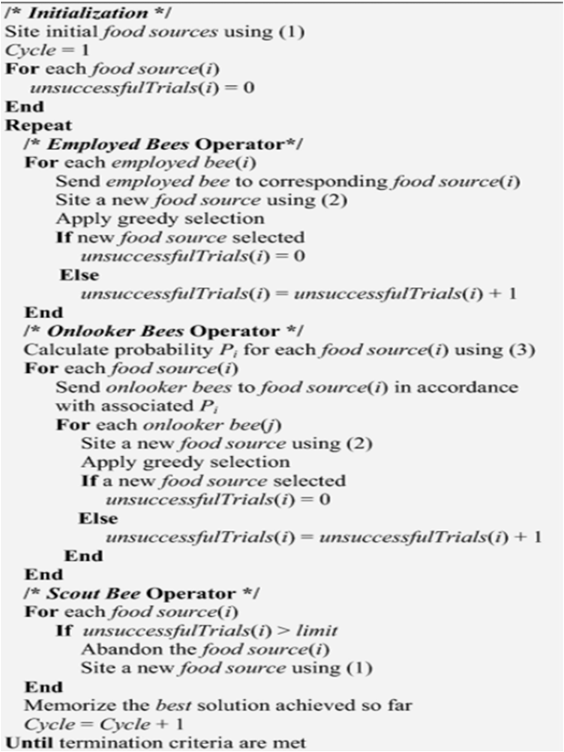
HYBRIDISATION OF ALGORITHMS
Variants for algorithms are created to make the algorithm give better results.
By hybridizing the algorithm with another combines the advantages of both the algorithm and gives better solution than a single algorithm.
The algorithm chosen to hybridize with the developed 4 algorithms is ABC (artificial bee colony algorithm).
The scout phase from this ABC algorithm is added with those 4 algorithms(PSO, TLBO, MBO, AOA).
The main reason of adding the scout phase is that, it increases the exploration and exploitation space and gives better pareto fronts by replacing the retained solutions and replacing it with a random one.
Easy to implement and hybridize with other algorithms.
All these algorithms are compared using those performance indicators. The best performing algorithm after testing those with different data sets is presented in next section.

Slide 47
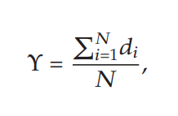
PERFORMANCE INDICATORS
PI 1 - NUMBER OF NON DOMINATED SOLUTIONS FOUND
The number of non-dominated solution generated by each algorithm in Pareto solution.
Higher PI 1 shows better algorithm performance.
PI 2 - ERROR RATIO
The number of solution which is not member of the Pareto optimal set divided by the number of solution generated by the algorithm.
Smaller PI 2 shows better algorithm performance.
PI 3 - CONVERGENCE METRIC
This metric measures the extent of convergence to a known set of Pareto optimal solutions, as follows:
where, N is the number of nondominated solutions obtained with an algorithm and,
di is the Euclidean distance between each of the nondominated solutions and the nearest member of the true Pareto optimal front.

Slide 48
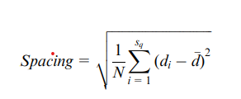
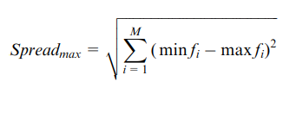

PERFORMANCE INDICATORS
PI 4 - SPACING
This indicator measures the relative distance between each solution.
where, di is the distance between solution i and the nearest solution, while d is the average of all di.
The smaller spacing index shows better solution and has better space between each solution.
PI 5 - MAXIMUM SPREAD
The spread of solution found by each algorithm.
Larger maximum spread is better.
PERFORMANCE INDICATOR | PI 1 | PI 2 | PI 3 | PI 4 | PI 5
BETTER PERFORMANCE

Slide 49
7.RESULTS
7.1. ITERATIONS AND POPULATION SIZE FINE TUNING
7.2. FINE TUNING OF PARAMETERS
7.3. COMPARISON OF ALL ALGORITHMS USING PERFORMANCE INDICATORS
7.4. VISUALISATION OF PARETO FRONTS OBTAINED

Slide 50
FINE TUNING OF ITERATIONS & POPULATION SIZE
The number of iterations and population size is actually given by the user, but for different sized data, the population size and iterations must be varied so that the results obtained is optimal.
To do this, all the algorithms are tested with different sized datasets namely,
Small - 0 < Number of tasks <= 50
Medium - 50 < Number of tasks <= 100
Large - Number of tasks > 100
The obtained results are compared using the performance indicators and the number of iterations and population size are fixed accordingly.
The sizes of iterations and population is considered as same to get better results. The various types tested with are,
Series 1 - T = 5 , P = 5
Series 2 - T = 10, P = 10
Series 3 - T = 15, P = 15
Series 4 - T = 20, P = 20
Series 5 - T = 25, P = 25
Series 6 - T = 30, P = 30
Where,
T = Number of iterations
P = population size

Slide 51
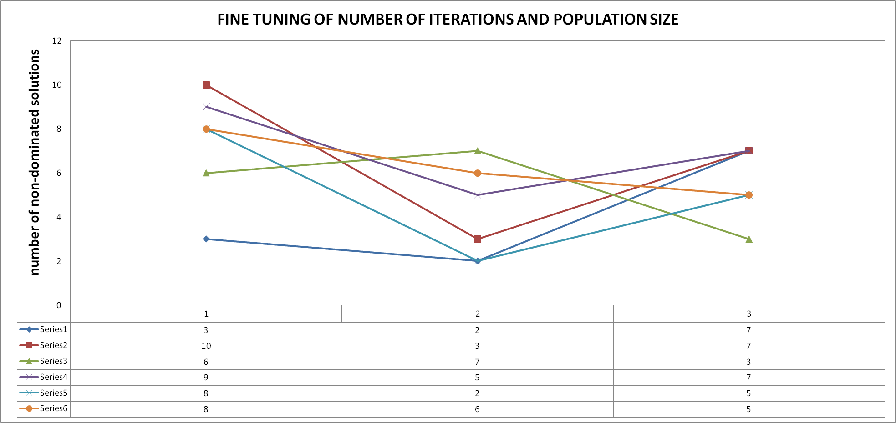
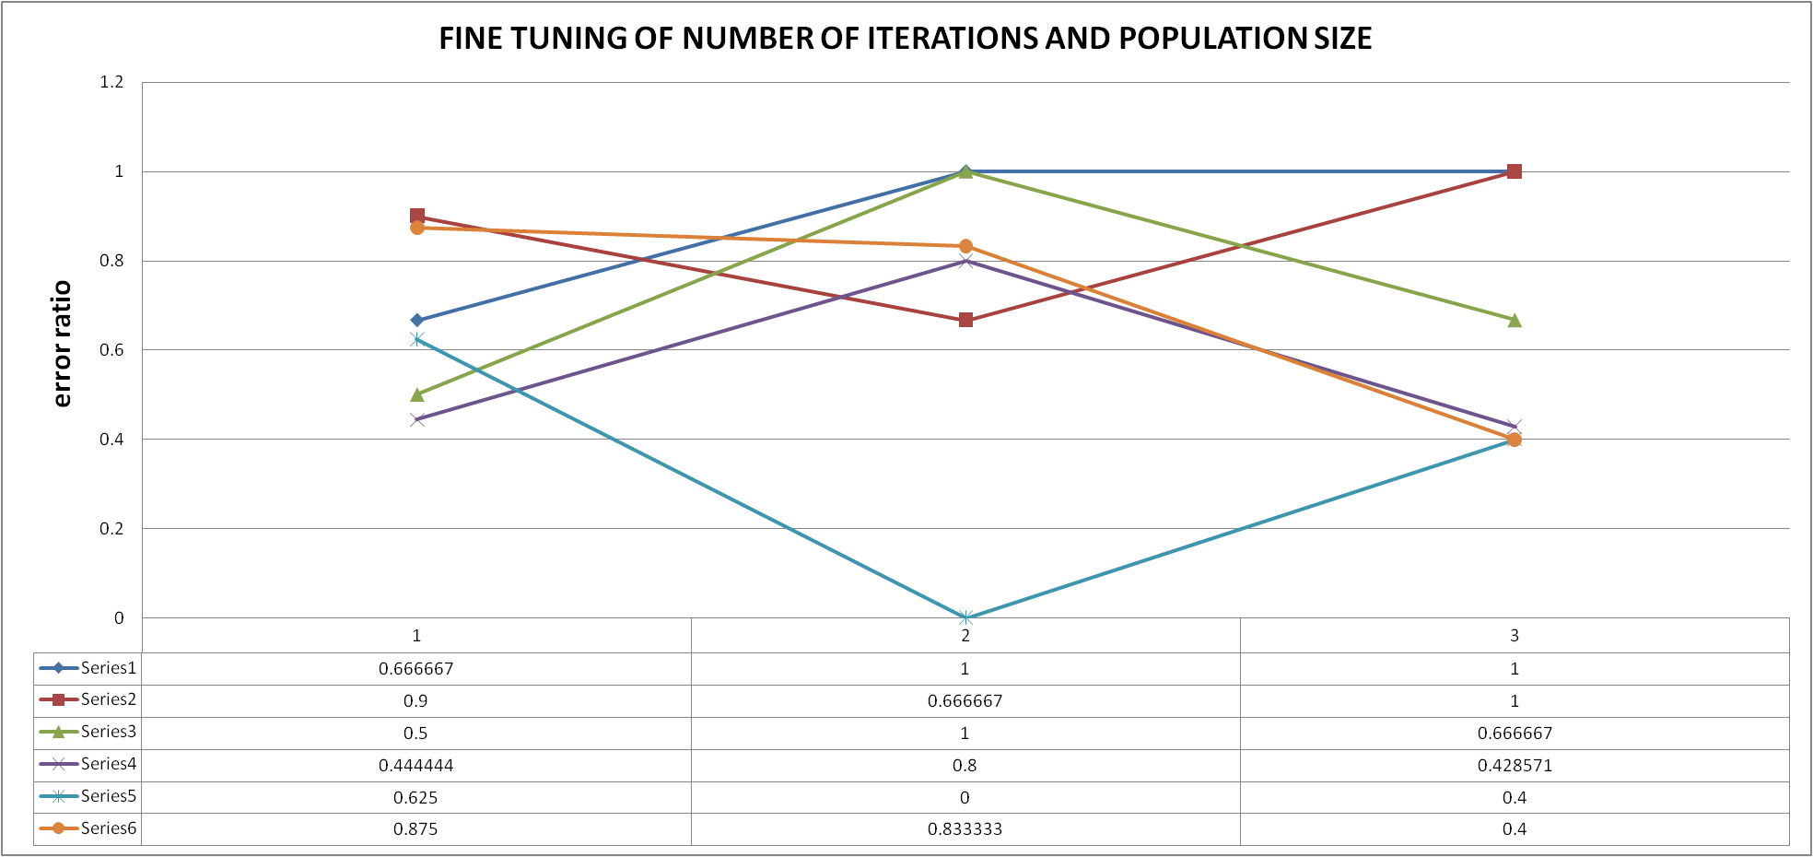
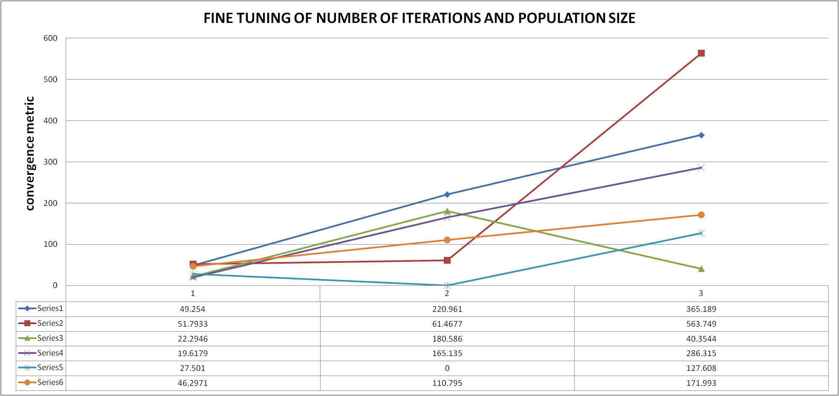
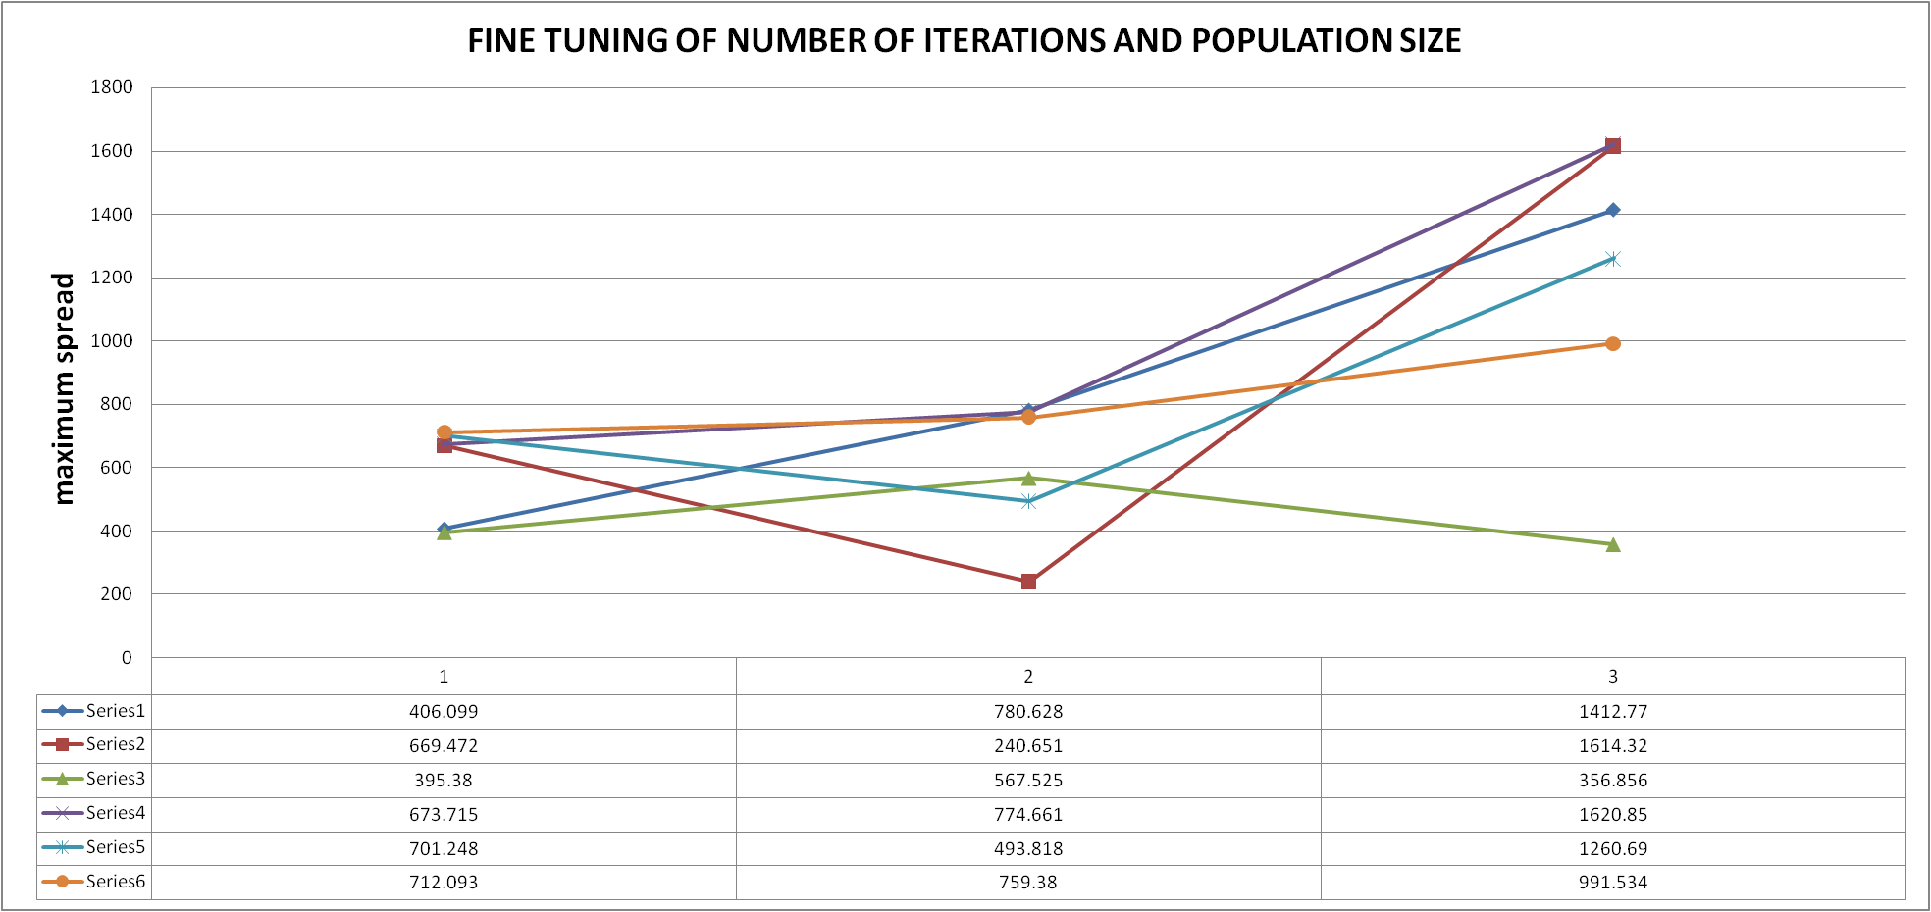
FINE TUNING FOR PSO

Slide 52
FINE TUNING FOR PSO
PROBLEM SIZE | PI 1 | PI 2 | PI 3 | PI 4 | PI 5 | OVERALL
Small | series 2 | series 4 | series 4 | series 1 | series 6 | series 4
Medium | series 3 | series 5 | series 5 | series 5 | series 6 | series 5
Large | series 4 | series 6 | series 3 | series 6 | series 4 | series 6
Series 1 - T = 5 , P = 5
Series 2 - T = 10, P = 10
Series 3 - T = 15, P = 15
Series 4 - T = 20, P = 20
Series 5 - T = 25, P = 25
Series 6 - T = 30, P = 30
PI 1 - number of non dominated solutions
PI 2 - error ratio
PI 3 - convergence metric
PI 4 - spacing
PI 5 - maximum spread

Slide 53
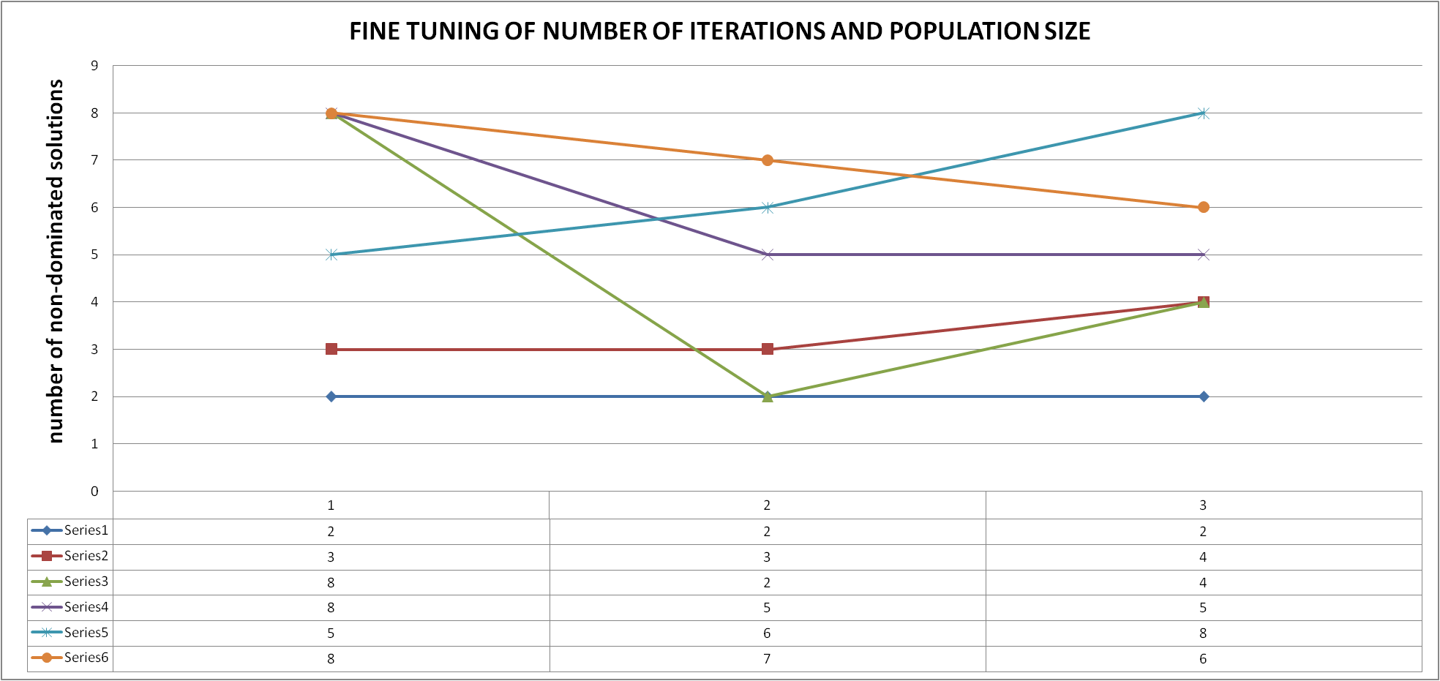
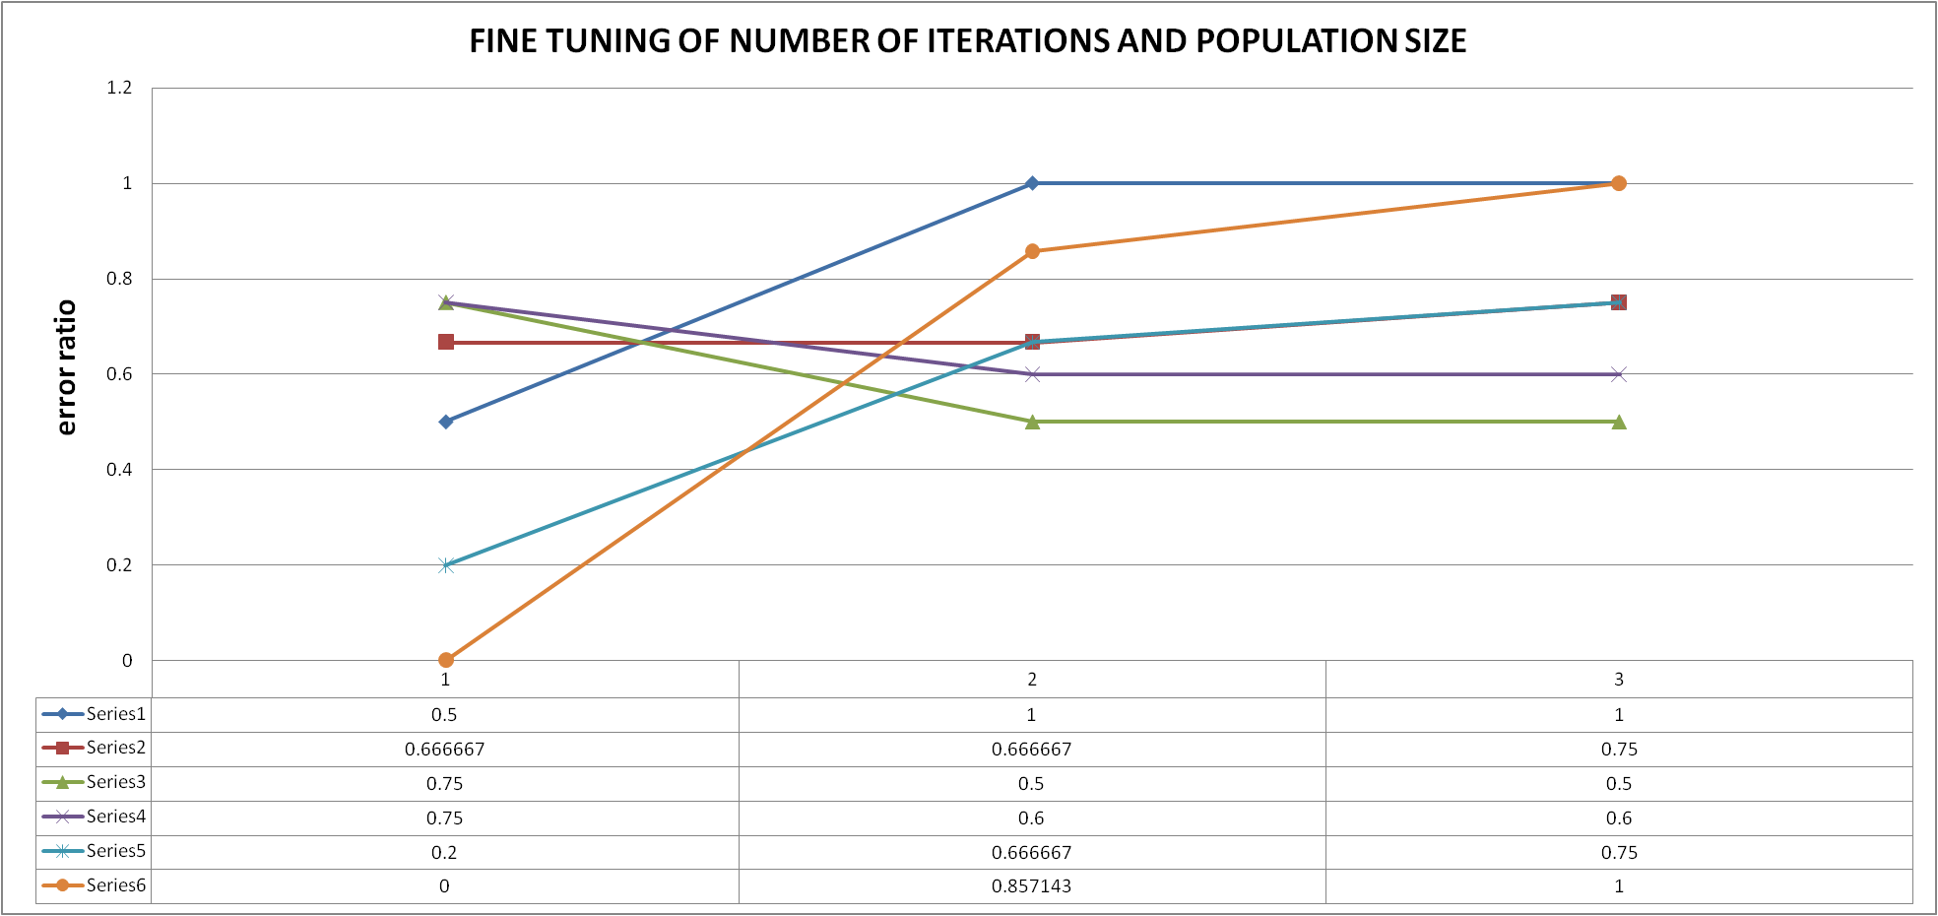
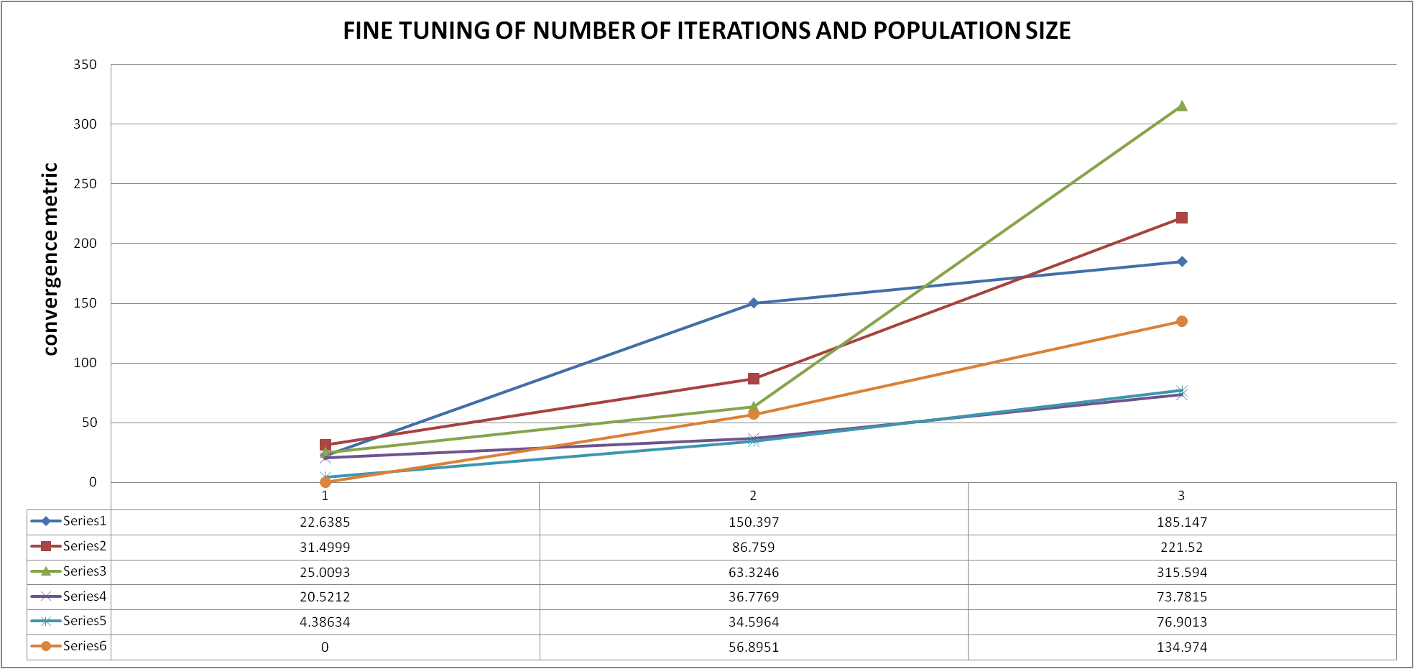
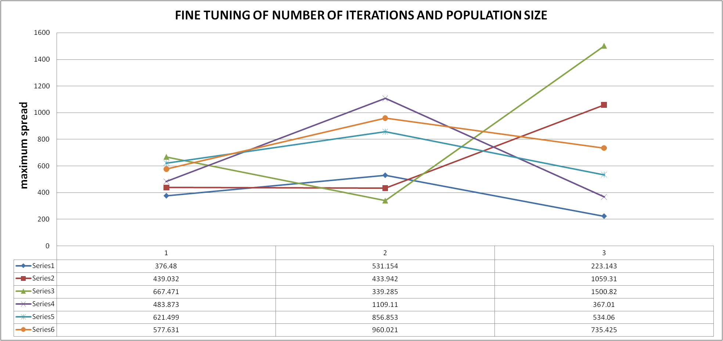
FINE TUNING FOR TLBO

Slide 54
FINE TUNING FOR TLBO
PROBLEM SIZE | PI 1 | PI 2 | PI 3 | PI 4 | PI 5 | OVERALL
Small | series 3 | series 5 | series 5 | series 4 | series 3 | series 3
Medium | series 6 | series 3 | series 5 | series 6 | series 5 | series 5
Large | series 5 | series 3 | series 5 | series 4 | series 3 | series 5
Series 1 - T = 5 , P = 5
Series 2 - T = 10, P = 10
Series 3 - T = 15, P = 15
Series 4 - T = 20, P = 20
Series 5 - T = 25, P = 25
Series 6 - T = 30, P = 30
PI 1 - number of non dominated solutions
PI 2 - error ratio
PI 3 - convergence metric
PI 4 - spacing
PI 5 - maximum spread

Slide 55
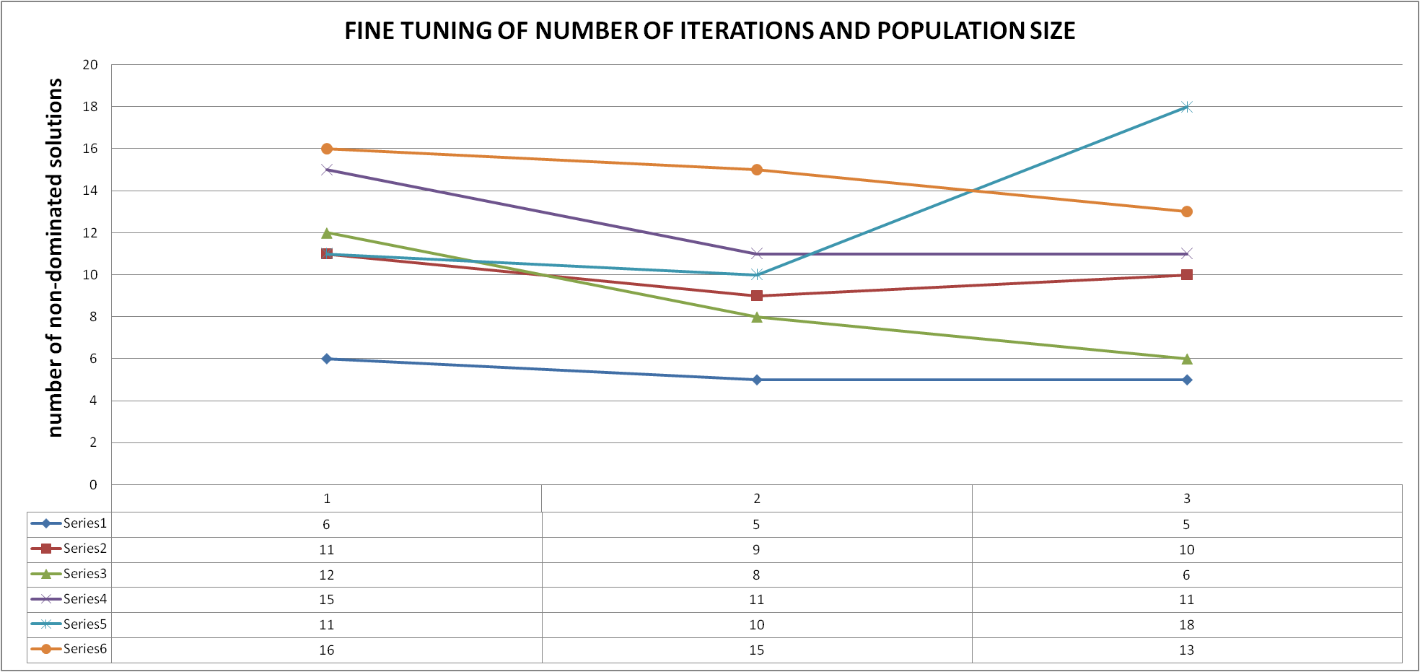
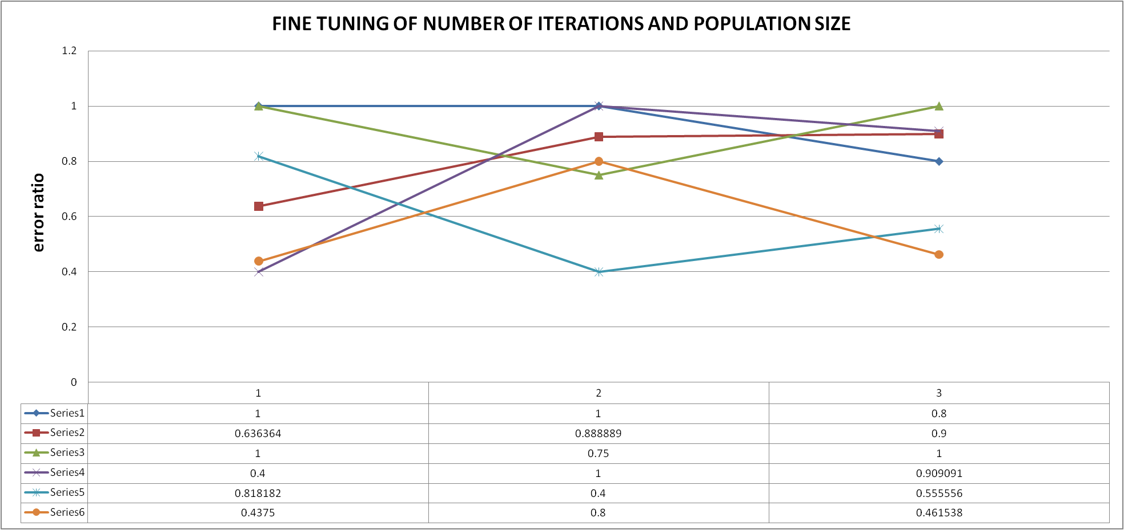
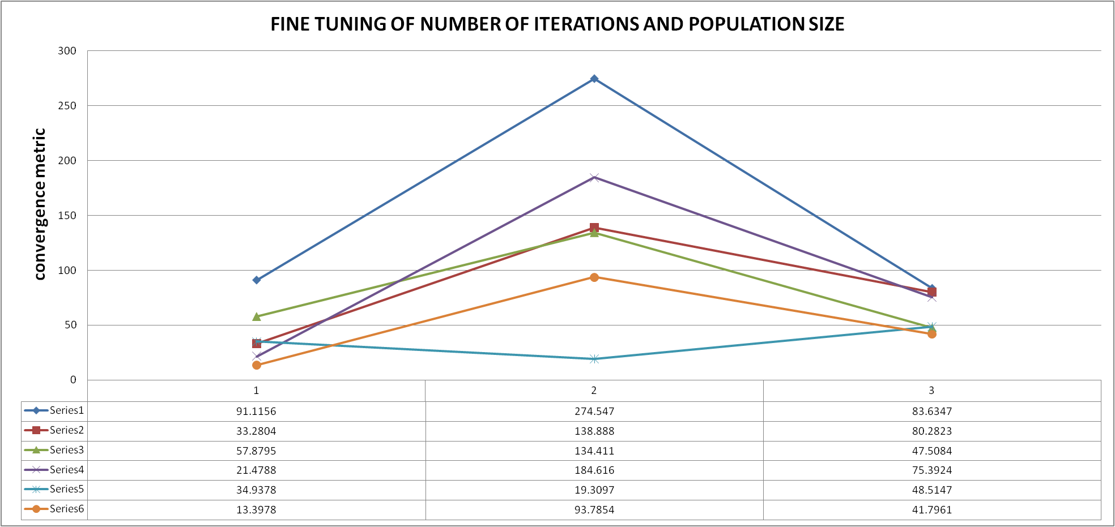
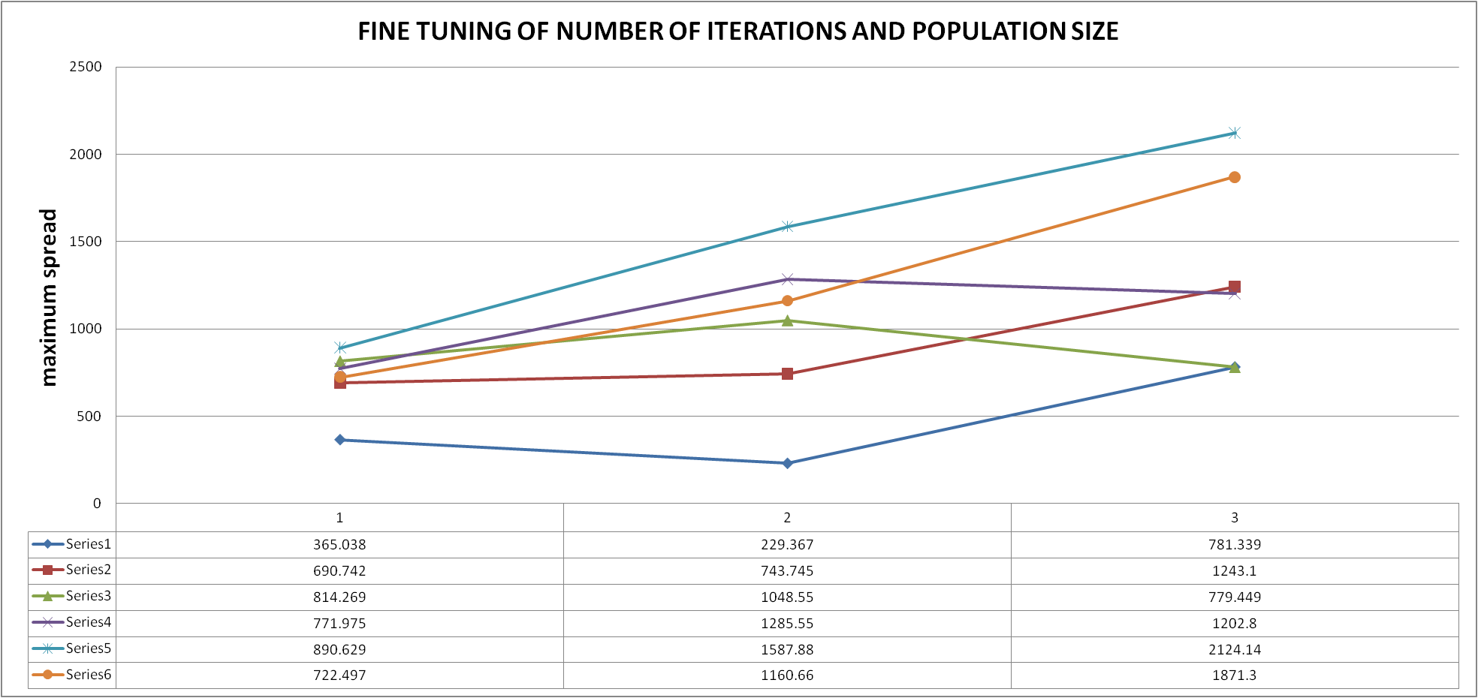
FINE TUNING FOR MBO

Slide 56
FINE TUNING FOR MBO
PROBLEM SIZE | PI 1 | PI 2 | PI 3 | PI 4 | PI 5 | OVERALL
Small | series 6 | series 4 | series 6 | series 4 | series 5 | series 4
Medium | series 6 | series 5 | series 5 | series 3 | series 5 | series 5
Large | series 5 | series 6 | series 6 | series 3 | series 5 | series 6
Series 1 - T = 5 , P = 5
Series 2 - T = 10, P = 10
Series 3 - T = 15, P = 15
Series 4 - T = 20, P = 20
Series 5 - T = 25, P = 25
Series 6 - T = 30, P = 30
PI 1 - number of non dominated solutions
PI 2 - error ratio
PI 3 - convergence metric
PI 4 - spacing
PI 5 - maximum spread

Slide 57
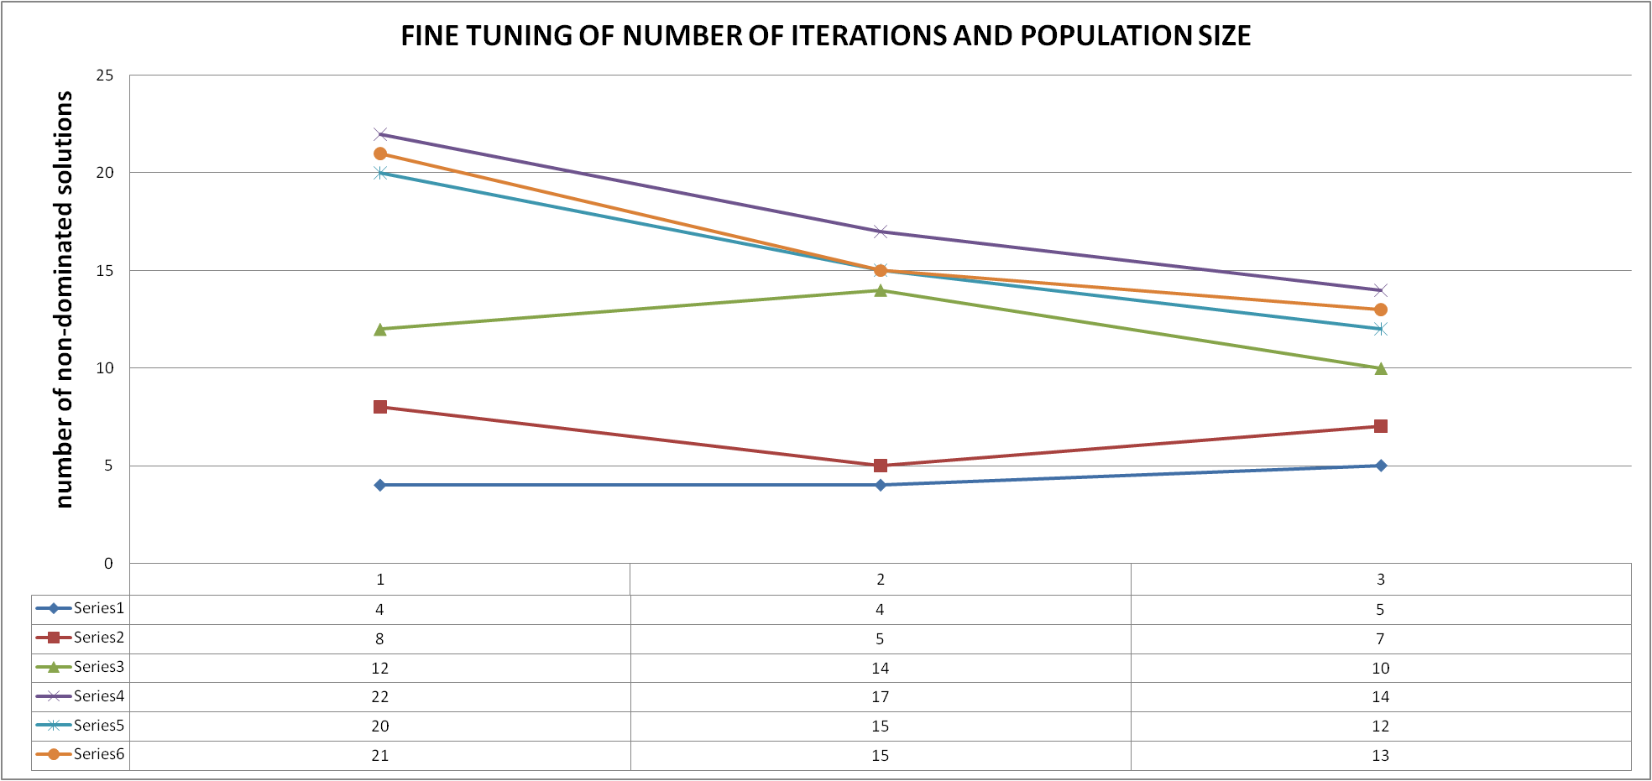
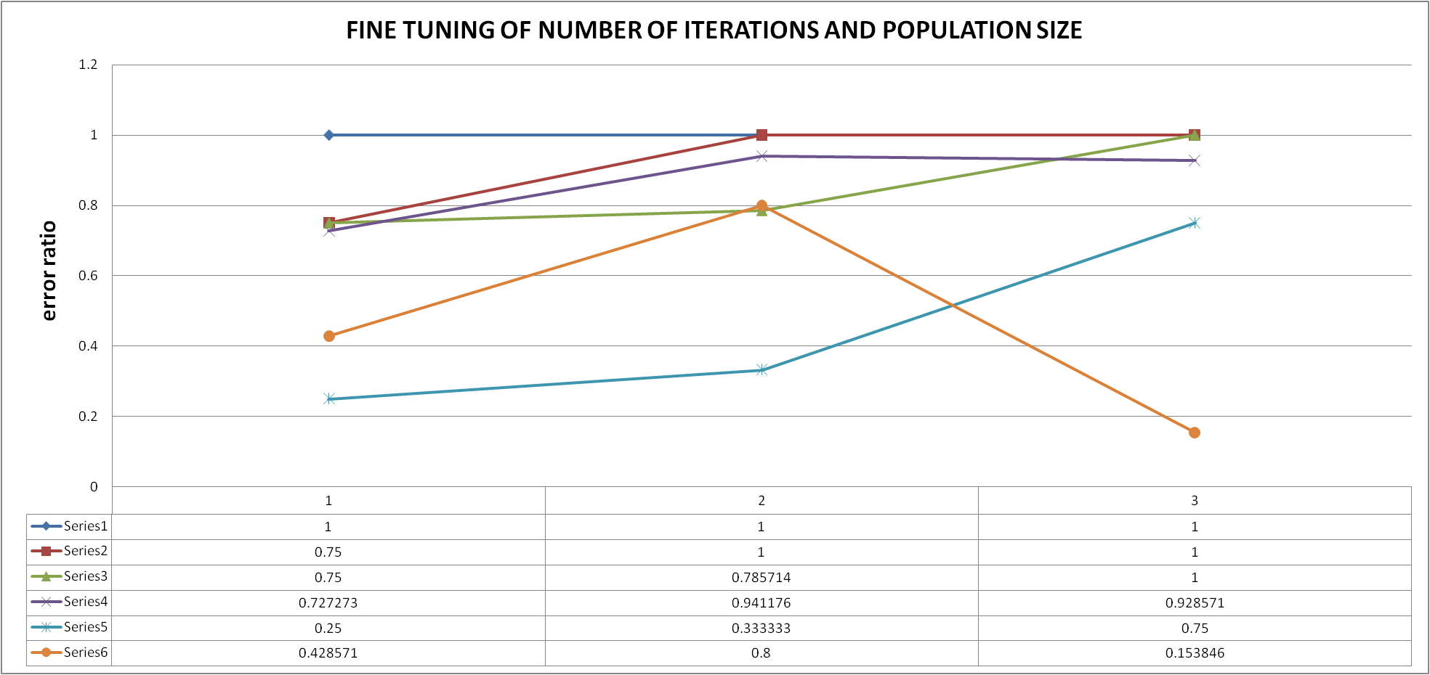
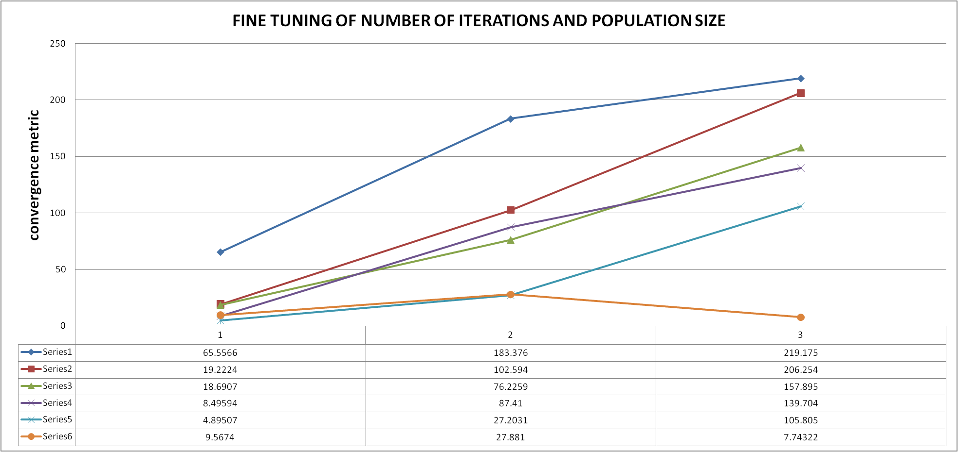
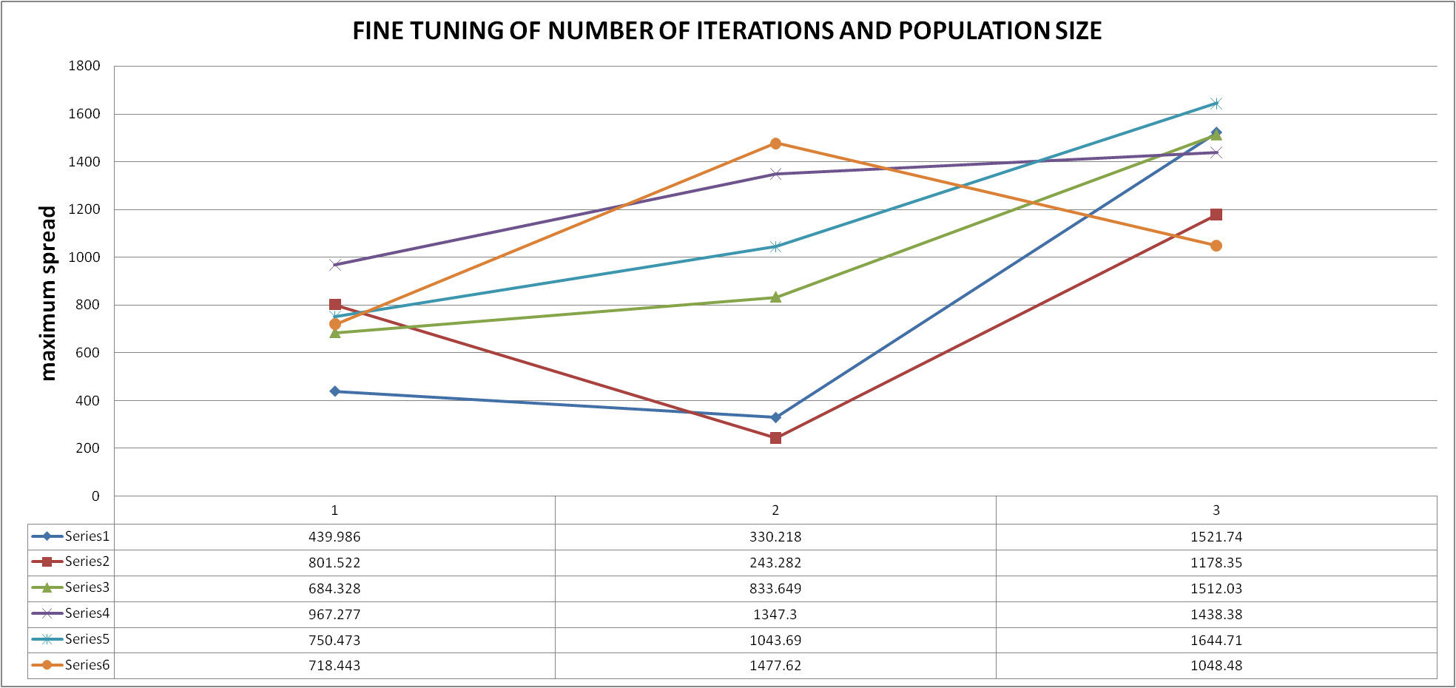
FINE TUNING FOR AOA

Slide 58
FINE TUNING FOR AOA
PROBLEM SIZE | PI 1 | PI 2 | PI 3 | PI 4 | PI 5 | OVERALL
Small | series 4 | series 5 | series 6 | series 5 | series 4 | series 5
Medium | series 4 | series 5 | series 6 | series 2 | series 6 | series 6
Large | series 4 | series 6 | series 6 | series 6 | series 5 | series 6
Series 1 - T = 5 , P = 5
Series 2 - T = 10, P = 10
Series 3 - T = 15, P = 15
Series 4 - T = 20, P = 20
Series 5 - T = 25, P = 25
Series 6 - T = 30, P = 30
PI 1 - number of non dominated solutions
PI 2 - error ratio
PI 3 - convergence metric
PI 4 - spacing
PI 5 - maximum spread

Slide 59
OVERALL CONCLUSION OF ITERATIONS & POPULATION SIZE FINE TUNING
ALGORITHM | PSO | TLBO | MBO | AOA
SMALL | T = 20, P = 20 | T = 15, P = 15 | T = 20, P = 20 | T = 25, P = 25
MEDIUM | T = 25, P = 25 | T = 25, P = 25 | T = 25, P = 25 | T = 30, P = 30
LARGE | T = 30, P = 30 | T = 25, P = 25 | T = 25, P = 25 | T = 30, P = 30

Slide 60
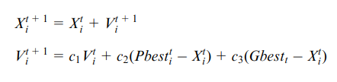
FINE TUNING OF PARAMETERS
For all the algorithms developed in our project, their respective parameters are fined tuned using certain efficient criteria as described below.
Thus for each algorithm, based on the size category(small, medium, large) of task data sets are graphs and tabulations of the “fine tuning criteria”. The best criteria is then tabulated based on the performance indicator values.
The given criteria for each algorithm are as follows:
MODIFIED DPSO
Series 1 - c1 ∈ (0, 0.5), c2+c3 <= 1.5
Series 2 - c1 ∈ (0.5, 1), c2+c3 <= 1.5
Series 3 - c2 ∈ (0, 0.5), c1+c3 <= 1.5
Series 4 - c2 ∈ (0.5, 1), c1+c3 <= 1.5
Series 5 - c3 ∈ (0, 0.5), c1+c2 <= 1.5
Series 6 - c3 ∈ (0.5, 1), c1+c2 <= 1.5
Where,
c1 = inertia weight
c2 = acceleration coefficient of P_best
c3 = acceleration coefficient of G_best
criterion

Slide 61
FINE TUNING OF PARAMETERS
TLBO
For each task number in i’th position of the sequences, if both the sequence do not have same task numbers, then a random number is generated between 0 and 1, which is then compared with coefficient (Tf/Tp) for further calculations for TLBO.
Series 1 - r ∈ (0, 0.5), Tf+Tp <= 1.5
Series 2 - r ∈ (0.5, 1), Tf+Tp <= 1.5
Series 3 - Tf ∈ (0, 0.5), r+Tp <= 1.5
Series 4 - Tf ∈ (0.5, 1), r+Tp <= 1.5
Series 5 - Tp ∈ (0, 0.5), r+Tf <= 1.5
Series 6 - Tp ∈ (0.5, 1), r+Tf <= 1.5
X_new = X_i + r * [ X_mean - (Tf * X_best) ]
X_new = X_i + r * [ X_i - (Tp * X_partner) ]
Where,
r = Coefficient that indicates the impact of the mean of the population and the teacher
Tf = Teaching coefficient that indicates the impact of teacher
Tp = Learning coefficient that indicates the impact of partner
criterion
MBO
Series 1 - K=2, X=1
Series 2 - K=3, X=1
Series 3 - K=5, X=2
Series 4 - K=5, X=3
Series 5 - K=7, X=3
Series 6 - K=10, X=5
K - represents number of neighbourhood solutions of current leader (employed during LEADER IMPROVEMENT PHASE)
X - represents any number less than K. (whose expression together with K are employed during the BLOCK IMPROVEMENT PHASE)
criterion

Slide 62




FINE TUNING OF PARAMETERS FOR PSO

Slide 63
FINE TUNING OF PARAMETERS FOR PSO
PROBLEM SIZE | PI 1 | PI 2 | PI 3 | PI 4 | PI 5 | OVERALL
Small | series 1 | series 1 | series 4 | series 5 | series 1 | series 1
Medium | series 6 | series 5 | series 4 | series 4 | series 6 | series 6
Large | series 2 | series 4 | series 4 | series 1 | series 4 | series 4
Series 1 - c1 ∈ (0, 0.5), c2+c3 <= 1.5
Series 2 - c1 ∈ (0.5, 1), c2+c3 <= 1.5
Series 3 - c2 ∈ (0, 0.5), c1+c3 <= 1.5
Series 4 - c2 ∈ (0.5, 1), c1+c3 <= 1.5
Series 5 - c3 ∈ (0, 0.5), c1+c2 <= 1.5
Series 6 - c3 ∈ (0.5, 1), c1+c2 <= 1.5
PI 1 - number of non dominated solutions
PI 2 - error ratio
PI 3 - convergence metric
PI 4 - spacing
PI 5 - maximum spread

Slide 64




FINE TUNING OF PARAMETERS FOR TLBO

Slide 65
FINE TUNING OF PARAMETERS FOR TLBO
PROBLEM SIZE | PI 1 | PI 2 | PI 3 | PI 4 | PI 5 | OVERALL
Small | series 3 | series 3 | series 5 | series 5 | series 3 | series 3
Medium | series 2 | series 6 | series 6 | series 2 | series 5 | series 6
Large | series 3 | series 2 | series 1 | series 6 | series 3 | series 3
Series 1 - r ∈ (0, 0.5), Tf+Tp <= 1.5
Series 2 - r ∈ (0.5, 1), Tf+Tp <= 1.5
Series 3 - Tf ∈ (0, 0.5), r+Tp <= 1.5
Series 4 - Tf ∈ (0.5, 1), r+Tp <= 1.5
Series 5 - Tp ∈ (0, 0.5), r+Tf <= 1.5
Series 6 - Tp ∈ (0.5, 1), r+Tf <= 1.5
PI 1 - number of non dominated solutions
PI 2 - error ratio
PI 3 - convergence metric
PI 4 - spacing
PI 5 - maximum spread

Slide 66




FINE TUNING OF PARAMETERS FOR MBO

Slide 67
FINE TUNING OF PARAMETERS FOR MBO
PROBLEM SIZE | PI 1 | PI 2 | PI 3 | PI 4 | PI 5 | OVERALL
Small | series 2 | series 4 | series 4 | series 2 | series 1 | series 4
Medium | series 2 | series 2 | series 2 | series 6 | series 4 | series 2
Large | series 3 | series 4 | series 2 | series 6 | series 3 | series 3
Series 1 - K=2, X=1
Series 2 - K=3, X=1
Series 3 - K=5, X=2
Series 4 - K=5, X=3
Series 5 - K=7, X=3
Series 6 - K=10, X=5
PI 1 - number of non dominated solutions
PI 2 - error ratio
PI 3 - convergence metric
PI 4 - spacing
PI 5 - maximum spread

Slide 68
OVERALL CONCLUSION OF PARAMETERS FINE TUNING
ALGORITHM | PSO | TLBO | MBO | AOA
SMALL | c1 = [0 - 0.5] c2 + c3 <= 1.5 | Tf = [0 - 0.5] r + Tp <= 1.5 | K = 5 X = 3 | -------
MEDIUM | c3 = [0.5 - 1] c1 + c2 <= 1.5 | Tp = [0.5 - 1] r + Tf <= 1.5 | K = 3 X = 1 | -------
LARGE | c2 = [0.5 - 1] c1 + c3 <= 1.5 | Tf = [0 - 0.5] r + Tp <= 1.5 | K = 5 X = 2 | -------

Slide 69
COMPARISON OF ALL ALGORITHMS
After adding the scout phase for the four algorithms developed, we now have to compare all the 8 algorithms.
To make the comparison easier, we segregated the data as small, medium and large as mentioned in earlier slides.
A total of 32 datasets is generated and used to compare these algorithms using the 5 performance indicators.
The description of each data set is explained in upcoming slides.
The base four algorithms,
PSO (particle swarm optimisation) - ALGO 1
TLBO (teaching learning based optimisation) - ALGO 2
MBO (migrating bird optimisation) - ALGO 3
AOA (archimedes optimisation algorithm) - ALGO 4
And the variants,
PSO + ABC (particle swarm optimisation with scout phase) - ALGO 5
TLBO + ABC (teaching learning based optimisation with scout phase) - ALGO 6
MBO + ABC (migrating bird optimisation with scout phase) - ALGO 7
AOA + ABC (archimedes optimisation algorithm with scout phase) - ALGO 8
Are plotted in separate graphs to make it easier for the user to visualise the graphs. The results obtained are as follows:

Slide 70



Slide 71



Slide 72



Slide 73



Slide 74



Slide 75
CONSOLIDATED RESULT
PSO-1 | PSO+ABC-2 | TLBO-3 | TLBO+ABC-4 | MBO-5 | MBO+ABC- 6 | AOA-7 | AOA+ABC - 8
DATA SET no. | No. of | No. of workstations | PROBLEM SIZE | PI 1 | PI 2 | PI 3 | PI 4 | PI 5 | OVERALL
 | tasks
1 | 25 | 3 | SMALL | 6 | 7 | 7 | 8 | 6 | 6, 7
2 | 25 | 4 | SMALL | 6 | 7 | 7 | 1 | 8 | 7
3 | 25 | 6 | SMALL | 7 | 8 | 8 | 7 | 7 | 7
4 | 25 | 9 | SMALL | 6 | 8 | 8 | 6 | 5 | 6, 8
5 | 35 | 4 | SMALL | 8 | 7 | 7 | 4 | 1 | 7
6 | 35 | 5 | SMALL | 7 | 7 | 8 | 8 | 7 | 7
7 | 35 | 7 | SMALL | 7 | 8 | 8 | 1 | 6 | 8
8 | 35 | 12 | SMALL | 8 | 8 | 6 | 1 | 8 | 8

Slide 76
9 | 53 | 5 | MEDIUM | 7 | 4 | 4 | 5 | 8 | 4
10 | 53 | 7 | MEDIUM | 8 | 8 | 7 | 3 | 8 | 8
11 | 53 | 10 | MEDIUM | 6 | 8 | 7 | 7 | 8 | 7, 8
12 | 53 | 14 | MEDIUM | 8 | 7 | 7 | 6 | 7 | 7
13 | 70 | 7 | MEDIUM | 8 | 8 | 8 | 6 | 7 | 8
14 | 70 | 10 | MEDIUM | 6 | 7 | 7 | 5 | 6 | 6, 7
15 | 70 | 14 | MEDIUM | 7 | 5 | 5 | 2 | 5 | 5
16 | 70 | 19 | MEDIUM | 8 | 8 | 8 | 2 | 8 | 8
17 | 89 | 8 | MEDIUM | 8 | 5 | 6 | 5 | 7 | 5
18 | 89 | 12 | MEDIUM | 7 | 7 | 7 | 4 | 8 | 7
19 | 89 | 16 | MEDIUM | 8 | 7 | 7 | 8 | 8 | 8
20 | 89 | 21 | MEDIUM | 7 | 8 | 8 | 7 | 8 | 8

Slide 77
21 | 111 | 9 | LARGE | 8 | 7 | 7 | 4 | 6 | 7
22 | 111 | 13 | LARGE | 6 | 7 | 7 | 2 | 6 | 6, 7
23 | 111 | 17 | LARGE | 7 | 8 | 8 | 3 | 7 | 7, 8
24 | 111 | 22 | LARGE | 6 | 8 | 8 | 5 | 6 | 6, 8
25 | 148 | 10 | LARGE | 6 | 8 | 8 | 6 | 7 | 6, 8
26 | 148 | 14 | LARGE | 8 | 7 | 8 | 2 | 6 | 8
27 | 148 | 21 | LARGE | 5 | 8 | 8 | 5 | 1 | 5, 8
28 | 148 | 29 | LARGE | 5 | 7 | 7 | 5 | 6 | 5, 7
29 | 297 | 19 | LARGE | 8 | 8 | 8 | 6 | 4 | 8
30 | 297 | 29 | LARGE | 5 | 5 | 7 | 2 | 8 | 5
31 | 297 | 38 | LARGE | 6 | 7 | 7 | 4 | 8 | 7
32 | 297 | 50 | LARGE | 6 | 1 | 8 | 7 | 7 | 7

Slide 78
CONSOLIDATED RESULT
PROBLEM SIZE | Algo 1 | Algo 2 | Algo 3 | Algo 4 | Algo 5 | Algo 6 | Algo 7 | Algo 8 | OVERALL
Small | 0 | 0 | 0 | 0 | 0 | 2 | 5 | 3 | ALGO 7
Medium | 0 | 0 | 0 | 1 | 2 | 1 | 4 | 6 | ALGO 8
Large | 0 | 0 | 0 | 0 | 3 | 3 | 6 | 6 | ALGO 8
PSO - Algo 1
TLBO - Algo 3
MBO - Algo 5
AOA - Algo 7
PSO + ABC - Algo 2
TLBO + ABC - Algo 4
MBO + ABC - Algo 6
AOA + ABC - Algo 8

Slide 79


VISUALISATION OF RESULTS USING PARETO FRONT

Slide 80


VISUALISATION OF RESULTS USING PARETO FRONT

Slide 81


VISUALISATION OF RESULTS USING PARETO FRONT

Slide 82
8.GOALS FOR NEXT MEETING
To apply the developed algorithms for a case-study in real-time industrial assembly data through a permitted industrial visit.
Modify the algorithms according to industry-specific norms and present the balanced assembly line results.
Completion of final report and journal for publication.

Slide 83
9. MILESTONES
& GANTT CHART

Slide 84


Milestone

Slide 85


Coding the consecutive method to evaluate objective functions (cycle time and energy consumption).
Implementing the multi objective handling using modified fast and elitist non dominated sorting technique.
Coding the algorithms, PSO, TLBO, MBO & AOA.
Carried out extensive literature review for assembly line balancing, robotic assembly line specifications, and all of the implemented algorithms.
Parallel contribution towards deciding efficient task, resource, safety, ergonomics and layout constraints in the assembly line.
Implementing the hybrid version of all above 4 algorithms, i.e.., coding the scout phase from ABC algorithm and merging it with already coded algorithms.
Developing a code to generate the data according to the users specification for human robot collaborative assembly line.
Software implementation of all the above code into a single file which can be used by any user to run for different datasets.
Fine tuning the iterations and parameters of each algorithm for different sized datasets.
Modifying the code to read input from a file of any size.
Developing a code to read the tab separated file and evaluate performance indicators for each different algorithms to compare them.
Parallel contribution towards content synthesis for review and report formats.
Writing the output into a tab separated file for plotting the results and compare the algorithms.
Collectively helped identify the best possible graphical and numerical data representation ideology for performance of the developed algorithms.
Took initiative to obtain permit for an industrial case study at a semi-automated firm, with ideal environment in order to utilise the developed algorithms for case study and increase work novelty.

Slide 86
10. REFERENCES

Slide 87
Weckenborg, C., Kieckhäfer, K., Müller, C. et al. Balancing of assembly lines with collaborative robots. Bus Res 13, 93–132 (2020). https://doi.org/10.1007/s40685-019-0101-y
Tamás Koltai, Imre Dimény, Viola Gallina, Alexander Gaal, Chiara Sepe, An analysis of task assignment and cycle times when robots are added to human-operated assembly lines, using mathematical programming models, International Journal of Production Economics, Volume 242, 2021, 108292, ISSN 0925-5273, https://doi.org/10.1016/j.ijpe.2021.108292.
Nicole Berx, Wilm Decré, Ido Morag, Peter Chemweno, Liliane Pintelon, Identification and classification of risk factors for human-robot collaboration from a system-wide perspective, Computers & Industrial Engineering, Volume 163, 2022, 107827, ISSN 0360-8352, https://doi.org/10.1016/j.cie.2021.107827.
Tansel Dokeroglu, Ender Sevinc, Tayfun Kucukyilmaz, Ahmet Cosar, A survey on new generation metaheuristic algorithms, Computers & Industrial Engineering, Volume 137, 2019, 106040, ISSN 0360-8352, https://doi.org/10.1016/j.cie.2019.106040.
Amir Nourmohammadi, Masood Fathi, Amos H.C. Ng, Balancing and scheduling assembly lines with human-robot collaboration tasks, Computers & Operations Research, Volume 140, 2022, 105674, ISSN 0305-0548, https://doi.org/10.1016/j.cor.2021.105674.

Slide 88
Ana Correia Simões, Ana Pinto, Joana Santos, Sofia Pinheiro, David Romero, Designing human-robot collaboration (HRC) workspaces in industrial settings: A systematic literature review, Journal of Manufacturing Systems, Volume 62, 2022, Pages 28-43, ISSN 0278-6125, https://doi.org/10.1016/j.jmsy.2021.11.007.
Li, Zixiang & Janardhanan, Mukund Nilakantan & S.G., Ponnambalam. (2021). Cost-oriented robotic assembly line balancing problem with setup times: multi-objective algorithms. Journal of Intelligent Manufacturing. 32. 10.1007/s10845-020-01598-7.
Ya-jun Zhang, Ningjian Huang, Rober G. Radwin, Zheng Wang & Jingshan Li (2022) Flow time in a human-robot collaborative assembly process: Performance evaluation, system properties, and a case study, IISE Transactions, 54:3, 238-250, DOI: 10.1080/24725854.2021.1907489
Zeynel Abidin Çil, Zixiang Li, Suleyman Mete, Eren Özceylan, Mathematical model and bee algorithms for mixed-model assembly line balancing problem with physical human–robot collaboration, Applied Soft Computing, Volume 93, 2020, 106394, ISSN 1568-4946, https://doi.org/10.1016/j.asoc.2020.106394.
Li, Z., Janardhanan, M.N. & Tang, Q. Multi-objective migrating bird optimization algorithm for cost-oriented assembly line balancing problem with collaborative robots. Neural Comput & Applic 33, 8575–8596 (2021). https://doi.org/10.1007/s00521-020-05610-2

Slide 89

Hashim, F.A., Hussain, K., Houssein, E.H. et al. Archimedes optimization algorithm: a new metaheuristic algorithm for solving optimization problems. Appl Intell 51, 1531–1551 (2021). https://doi.org/10.1007/s10489-020-01893-z

